Slide 1
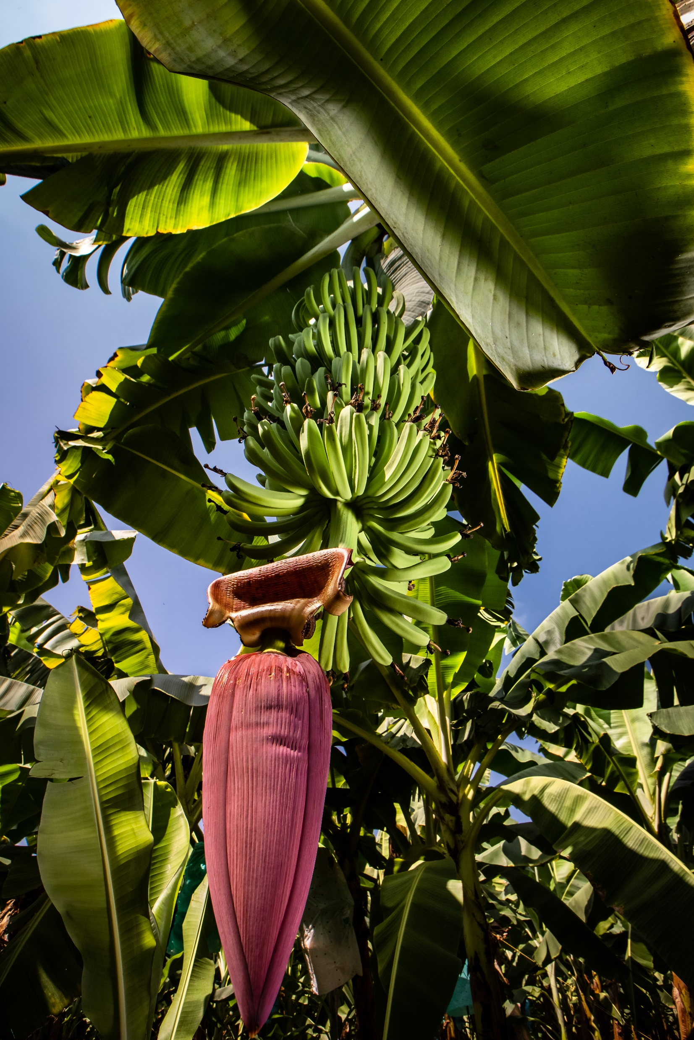

Fairtrade Fortnight 2023
Monday 27th Feb - Sunday 12th Mar
Protect the future of food, our planet and countless communities. Choose Fairtade.
Notes:
Hello and thank you so much for listening to me and getting involved in Fairtrade Fortnight.
Fairtrade Fortnight is a special time each year when tens of thousands of people commit to take action. Action to deliver a fairer deal for people too often exploited by our deeply unfair global trade system.
Today, millions around the world, no matter how hard they work, are unable to earn enough for essentials like food, clean water and medical treatment because of modern trade structures built on the legacy of colonialism and centuries of exploitation.
With so many people unable to afford the essentials, communities in the countries that produce crops like coffee, cocoa and bananas are finding it extremely hard to adapt to climate change. Increasingly extreme and unpredictable weather is already threatening lives and livelihoods.
But this doesn’t just threaten the future of communities. It also threatens the future of crops like those I just mentioned – many expert predictions suggest certain crops could become much more difficult to find in future.
And that is what I’m going to talk about over the next 30 minutes or so.

Slide 2


Hello!
1
Notes:
(Use this slide to introduce yourself)

Slide 3

Reality of the climate crisis
3
Notes:
So let’s start by exploring the reality of the Climate Crisis for farmers and workers growing our Fairtrade favourites. To do that, we’ll hear directly from some cocoa farmers in Ghana, living with the reality of climate change, the cost of living crisis and centuries of unfair global trade.

Slide 4
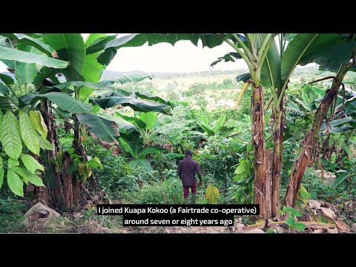
3
Notes:
Play video. Video can also be found on Youtube: https://youtu.be/HFo3OzCZC6w

Slide 5
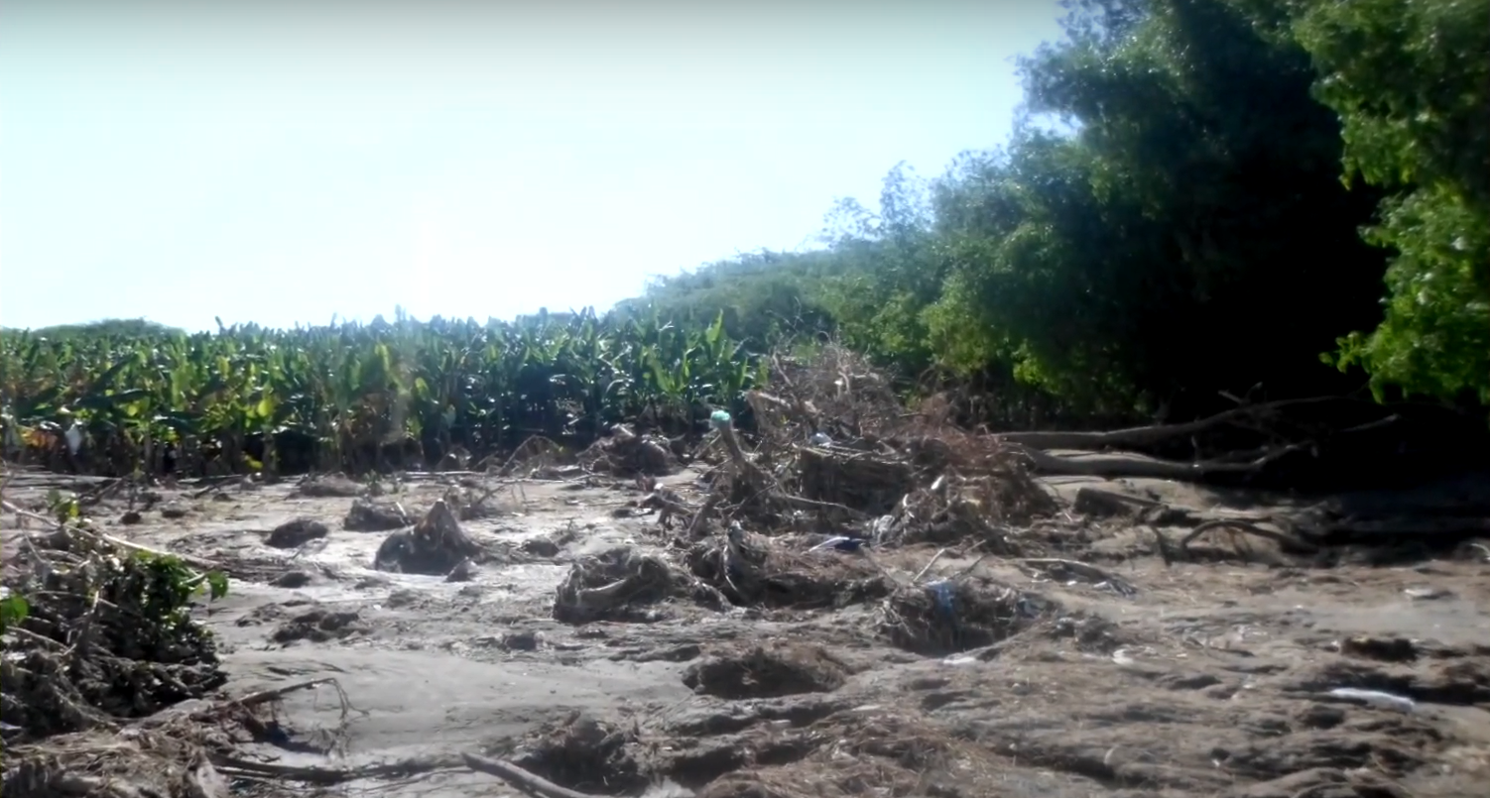
The reality of the climate crisis
Areas where many Fairtrade products are produced, including Central America, East Africa and the Caribbean, are very likely to experience increasingly extreme weather which will negatively affect their ability to grow crops.
This puts farmers’ livelihoods in danger.
Fairtrade banana growers in the Dominican Republic have seen almost their entire crops destroyed by increasingly frequent natural disasters. They have used Fairtrade Premium to power their recovery.
Notes:
After a century of burning of fossil fuels and excessive use of coal oil and gas, global temperatures have risen by more than 1°C. The climate crisis is now the sad reality of how we discuss the irreversible damage to our planet and the international response to the issue.
Fairtrade banana farmers in the Dominican Republic are just one of the groups who have witnessed this sad reality first-hand.
This photo shows the aftermath of one of a number of increasingly frequent and increasingly extreme weather events (such as hurricanes and floods) they have experienced in recent years. Fairtrade Premium, generated from Fairtrade sales, has meant they have the resources to recover and better prepare for future challenges. But climate challenges like this inevitably make the future more uncertain for communities like those of the Las Mercedes banana growers in the Dominican Republic.
Research has shown areas where many Fairtrade products are produced, including Central America, East Africa and the Caribbean, are very likely to experience increasingly extreme weather which will negatively affect their ability to grow crops.
Extreme weather can mean droughts, flooding and increased plant diseases, which all put farmers’ livelihoods in danger.

Slide 6
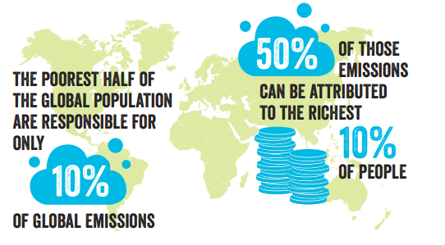
The Climate Crisis isn’t fair
Notes:
And although all of us live with the effects of the changing global climate, we do not feel it equally. And we are not equally responsible. The poorest half of the global population are responsible for only 10% of global emissions.
The richest 10 per cent meanwhile are responsible for half of all global emissions.
Or to put it another way, the carbon emissions of the top 1% of the global population are more than double the entire emissions of the lowest earning 50% of humanity.
Both statistics are from Oxfam’s 2020 Confronting Carbon Inequality report

Slide 7
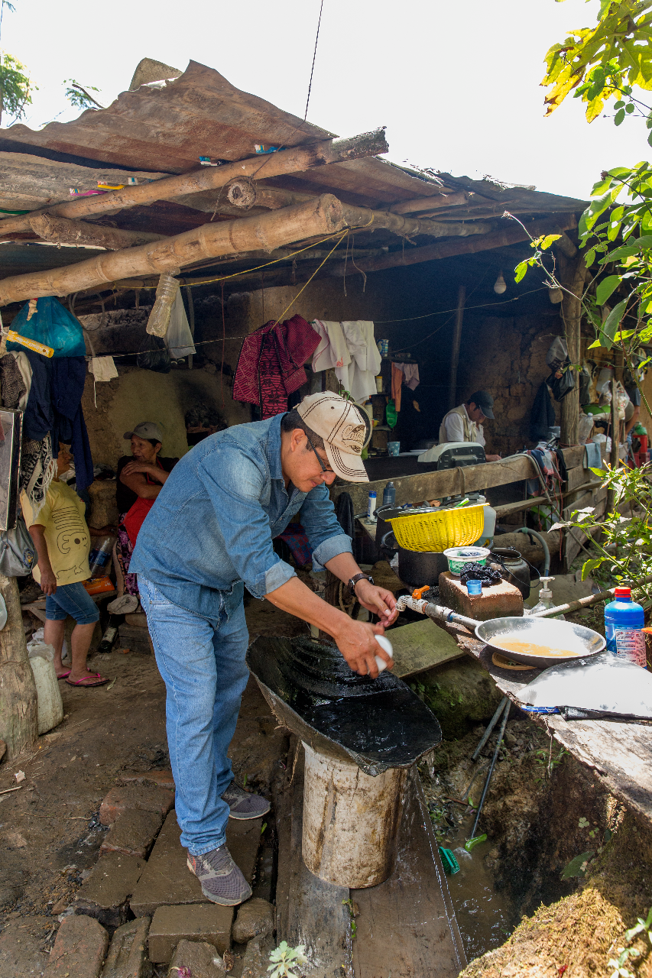
"Many prices have increased due to the rise in fuel costs … fish, oils, rice and flour. It is also very difficult on the farm because the cost of living increases every day and it is necessary to pay a little more to the people who work with us.” Hugo Guerrero, Fairtrade coffee farmer, Peru.
Notes:
But it is farmers like Hugo in Peru whose livelihood is under threat, even though Peru has been responsible for 40 times less carbon than the UK. (Source, Global Carbon Project: https://ourworldindata.org/contributed-most-global-co2)
Read quote

Slide 8
The impact of the cost of living crisis
How Fairtrade helps tackle cost-of-living across the world
Research proves that farmers that are members of Fairtrade certified organisations report greater economic resilience than non-Fairtrade farmers.
This is due to the Fairtrade Minimum Price and Premium, which can deliver fairer incomes for farmers and workers
But it’s also due to low- or no-interest loans, co-operative support for its members, and support in earning money from other sources and other training opportunities.
With the extra income and extra security Fairtrade can offer, farmers like Hugo can better plan for and adapt to the cost of living crisis and the effects of climate change.
Notes:
Grain, oil and fertiliser shortages during the pandemic and the war in Ukraine have exposed people in low-income countries to food poverty and hardship. As is true in this country, those earning the least all around the world have felt the worst effects of these crises, which have been made worse by climate change – the “worst droughts in two generations” in East Africa have led to extreme hunger during 2022.
How does Fairtrade helps tackle cost-of-living across the world?
Research proves that farmers that are members of Fairtrade certified organisations report greater economic resilience than non-Fairtrade farmers.
This is due to the Fairtrade Minimum Price and Premium, which can deliver fairer incomes for farmers and workers
But it’s also due to low- or no-interest loans, co-operative support for its members, and support in income diversification and other training opportunities.
With the extra income and extra security Fairtrade can offer, farmers like Hugo can better plan for and adapt to the cost of living crisis and the effects of climate change.

Slide 9
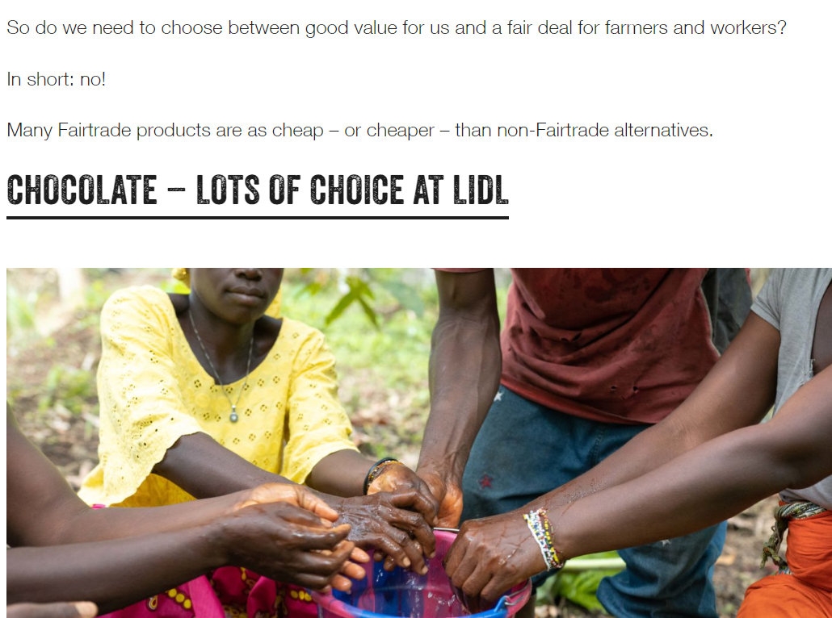
What about the cost of living in the UK?
Fairtrade doesn't have to cost you more
Fairtrade is all about pay, protection and power for farmers and workers across the world. It's not about how much you pay.
That's why so many supermarket own-brand ranges have Fairtrade options, and why you can find Fairtrade options in so many discount retailers.
Check out a few great value Fairtrade options on the Fairtrade Foundation website: https://bit.ly/FairtradeValue
Notes:
Fairtrade doesn't have to cost you more
Fairtrade is all about pay, protection and power for farmers and workers across the world. It's not about how much you pay.
That's why so many supermarket own-brand ranges have Fairtrade options, and why you can find Fairtrade options in so many discount retailers.
So whatever your budget and wherever you shop, consumers can choose Fairtrade products today to support farmers by ensuring they have fairer pay to face the climate crisis and continue producing the foods we love.

Slide 10
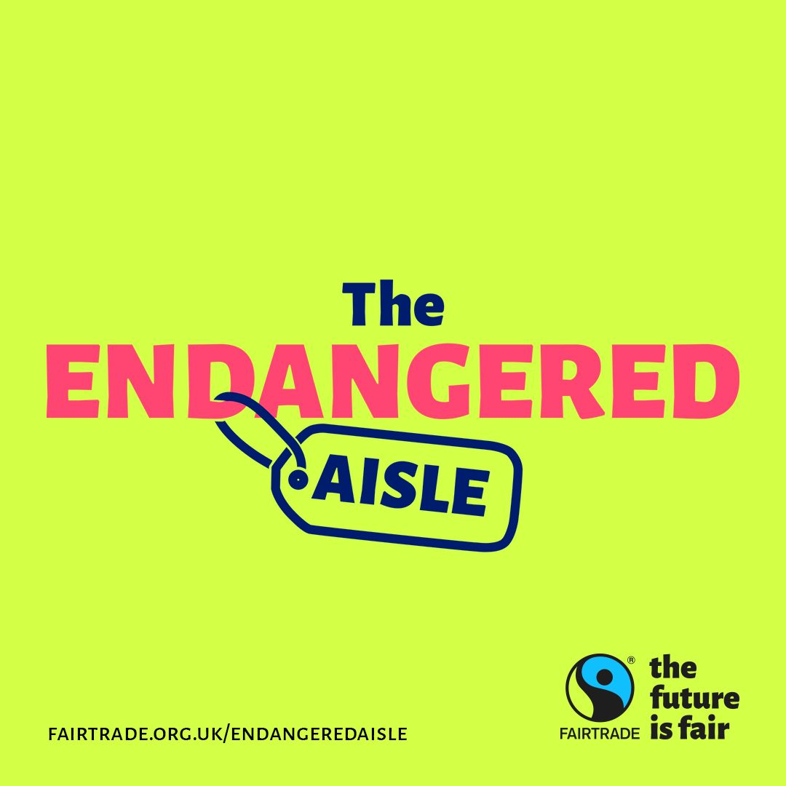
Endangered Aisle campaign
This year our Endangered Aisle campaign highlights the urgent threat to the future of the foods we love and the livelihoods of the people who grow them, as they face the worst effects of the climate crisis.
Smallholder farmers simply can’t foot the bill for adapting to economic and climate change on their current incomes. Without urgent action, our favourite foods could soon be much harder to find on UK shelves.
By choosing Fairtrade now, you’re taking a stand with farmers and workers worldwide for fairer incomes, so they can protect the future of our food.
Visit fairtrade.org.uk/endangeredaisle to find out more!
Notes:
That’s why we’re launching our Endangered Aisle campaign this Fairtrade Fortnight. It asks the question, what will happen if we don’t start paying farmers enough to both adapt to the climate crisis, take on the global cost of living emergency and meet their basic needs?
The Answer: Our favourite foods could soon be much harder to find on our shelves, as climate change and unfair trade force farmers out of business.
Our Endangered Aisle campaign highlights the urgent threat to the future of the foods we love and the livelihoods of the people who grow them. Without our support for fairer prices today, farmers will find it even harder to tackle the climate and economic challenges of the future. ​
We can act. Choose Fairtrade to back the farmers behind some of our favourite products to ensure they are paid more fairly and can keep farming through these huge global challenges

Slide 11
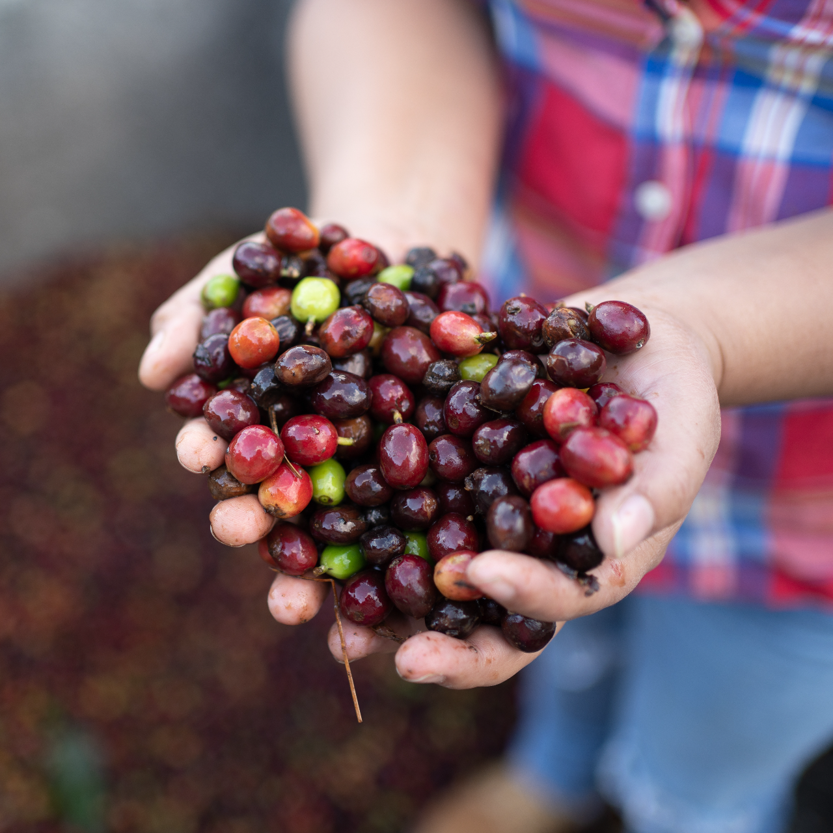
Which foods could be endangered?
Coffee
93% of the Fairtrade coffee farmers in Kenya surveyed are already experiencing the effects of climate change, including more plant diseases and increasingly erratic rainfall.
By 2050 up to half of the land currently used to farm coffee may be unusable.
Between 2012 and 2017, plant disease Coffee Rust caused more than $3 billion in damage and forced almost 2 million farmers off their land.
Esperanza Suazo Sáenz, Fairtrade coffee farmer, Honduras.
Notes:
Which crops are in danger due to climate change?
Research over the past few years has shown lots of our Fairtrade favourites could be endangered. And that could mean serious consequences for the future of coffee farmers like Hugo, who we met in a previous slide, or Esperanza, pictured holding some coffee cherries on this slide.
To give a few examples of what climate change means for coffee farmers:
93% of the Fairtrade coffee farmers in Kenya surveyed are already experiencing the effects of climate change, including more plant diseases and increasingly erratic rainfall.
By 2050 up to half of the land currently used to farm coffee may be unusable.
Between 2012 and 2017, plant disease Coffee Rust caused more than $3 billion in damage and forced almost 2 million farmers off their land.
Plant diseases, unpredictable weather and damage to soil quality combining with continued volatile coffee prices is a toxic mix for coffee farmers. Financial hardship could force their businesses to close, making coffee harder to get on supermarket shelves around the world.

Slide 12
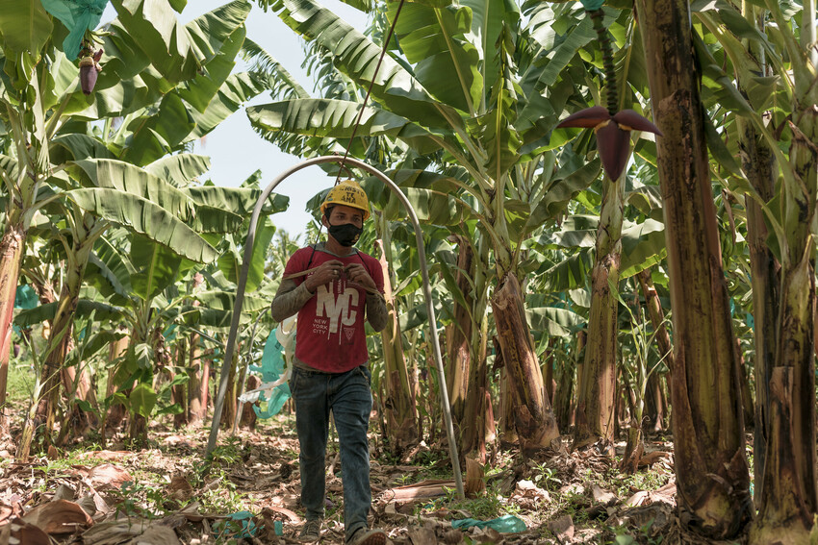
Which foods could be endangered?
Bananas
2017 floods in Peru which destroyed many banana crops were made more likely by the effects of climate change
Scientific reports have shown banana growers in the Caribbean and Latin America are being forced to prepare for more frequent heatwaves and droughts which will threaten their crops.
Although not directly related to climate change, the plant disease TR4 threatens the future of the world's most common banana species – the Cavendish banana.
Reymundo Villarreal, Fairtrade banana grower in Peru. He is taking on climate change by using natural fertilizers to make the plants more resilient
Notes:
Bananas too face real threats from climate change. To give two examples
2017 floods in Peru which destroyed many banana crops were made more likely by the effects of climate change
Banana growers in the Caribbean and Latin America are being forced to prepare for more frequent heatwaves and droughts which will threaten their crops.
Although not directly related to climate change, the plant disease TR4 threatens the future of the world's most common banana species – the Cavendish banana. Combined with climate change, this is a real threat to the future of many banana producers, like Reymundo Villarreal, Fairtrade banana grower in Peru.
With Fairtrade, he has been able to invest in using natural fertilizers to make the soil more resilient. But scaling up that work depends on more people choosing Fairtrade. And to tackle the root cause of the challenges facing banana growers like Reymundo, we need to see serious global action on climate change as well as fairer global trade structures.

Slide 13
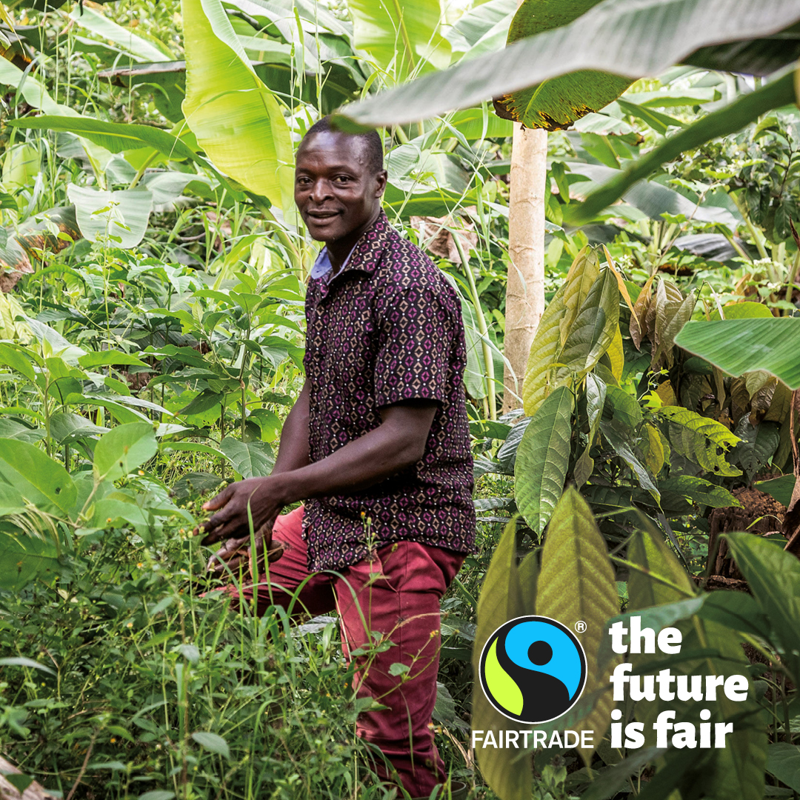
Which foods could be endangered?
Tea, chocolate and lots more
Increased heatwaves and drought will force cocoa farmers in Côte d'Ivoire and Ghana to adapt their farming methods to survive– something they need money to do sustainably
Fairtrade tea growers in India are already reporting more flooding, along with extreme temperatures and water scarcity, due to climate change.
In fact, 80 percent of the world’s food comes from 500 million family farms, where people are increasingly facing the worst effects of the climate crisis.
Those earning the least are most likely to be unable to continue. So climate change and unfair trade is a huge threat to the future of many of our favourite foods.
Sadick Abanga, 39, Fairtrade cocoa farmer, Ghana. Following a recent training project, Saddick has adopted more sustainable farming methods to take on the effects of climate change.
Notes:
In fact there are serious and immediate challenges facing almost all the crops and goods Fairtrade farmers and workers produce. To take two more examples.
Increased heatwaves and drought will force cocoa farmers in Côte d'Ivoire and Ghana to adapt their farming methods to survive– something they need money to do sustainably
Fairtrade tea growers in India are already reporting more flooding, along with extreme temperatures and water scarcity, due to climate change.
In fact, 80 percent of the world’s food comes from 500 million family farms, where people are increasingly facing the worst effects of the climate crisis.
Those earning the least are most likely to be unable to continue. So climate change and unfair trade is a huge threat to the future of many of our favourite foods.
And remember the climate crisis itself is deeply unfair. We all live with climate change, but those who did the least to cause it are already living with the worst consequences.

Slide 14
Endangered Aisle – find out more!
Want to find out more about the threat climate change poses to the future of food and the communities who produce it?
Visit www.fairtrade.org.uk/endangeredaisle during Fairtrade Fortnight to find out more.
Notes:
There’s lots of interesting material being created around our ‘Endangered Aisle’ campaign. To find out more please visit fairtrade.org.uk/endangeredaisle

Slide 15

You are part of the solution
7
Notes:
How can we take on these challenges? How can we be part of the solution?

Slide 16
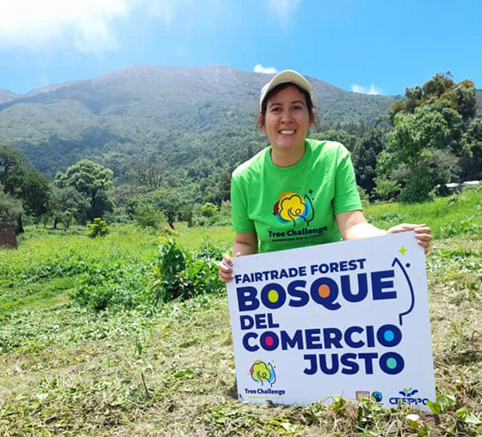
Buying & supporting Fairtrade
Buying Fairtrade leads to higher incomes for farmers, who can take positive steps to tackle climate change. For example, in 2022, Fairtrade producers across Latin America and the Caribbean have planted more than 300,000 trees in a six-month tree-planting drive.
Supporting Fairtrade products contributes to Fairtrade Premium spent on projects with an environmental impact included: clean water and sanitation facilities, composting programmes, crop diversification programmes
The Fairtrade Standards involve many environment protections, including promoting bio-diversity, preventing water waste and minimising carbon emissions
The ATAISI Co-operative in El Salvador (above), who produce Fairtrade coffee, honey and sugar, helped launch the Tree Challenge in 2022.
Notes:
Well one way is by buying and supporting Fairtrade
With higher incomes farmers can take positive steps. For example, in 2022, choosing to use Fairtrade Premium funds to cover their costs, Fairtrade producers across Latin America and the Caribbean have planted more than 300,000 trees in a six-month tree-planting drive, with more than 100 Fairtrade organizations across 20 countries getting involved. (Fairtrade producers plant more than 300,000 trees, highlighting urgent need for climate action -) You can see a representative from ATAISI Co-Operative in El Salvador celebrating the launch of this initiative on the slides. That co-operative produce Fairtrade coffee, honey and sugar, and now the farmland contains more trees that will both help tackle the climate crisis and protect their crops, local soil quality and bio-diversity.
In 2019/20, Fairtrade Premium spent on projects with an environmental impact included: clean water and sanitation facilities, composting programmes, crop diversification programmes, investment in energy infrastructure, community environmental programmes and farmer training in pest management, product quality improvement, productivity improvement, soil management and water management. (Fairtrade FairLens research)
The Fairtrade Standards involve many environmental protections, including promoting bio-diversity, preventing water waste and minimising carbon emissions

Slide 17

Emelia
Debrah’s
story
9
Notes:
Now let’s make it personal. Let’s explore the story of one particular Fairtrade cocoa farmer, and how she’s taken on these challenges using the power of Fairtrade. This is Emelia Debrah’s story

Slide 18
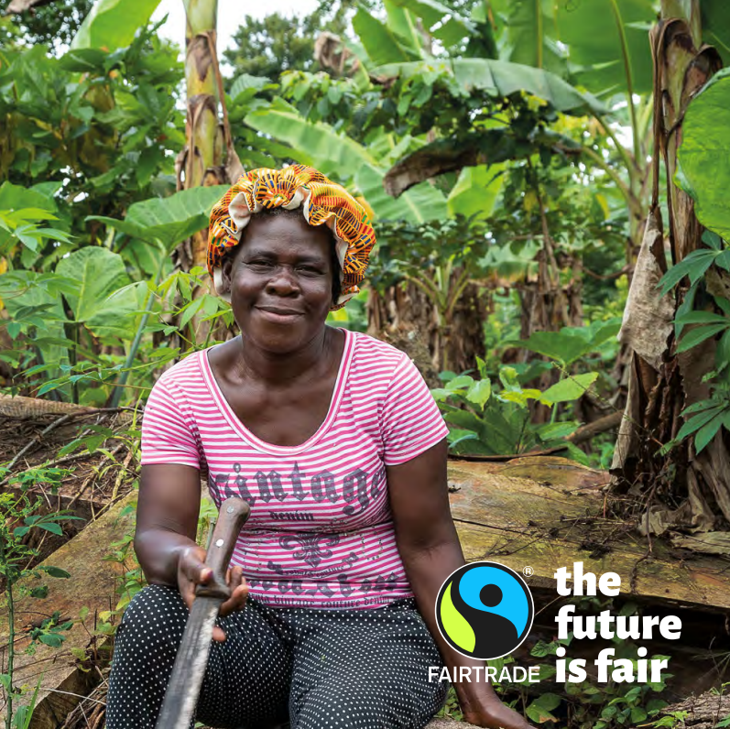
Emelia Debrah
Cocoa farmer from Ghana
Emelia Debrah, is a cocoa farmer who had previously struggled with debt and was able to turn her finances around with the support of her Fairtrade co-op.
Emelia received training and support which allowed her to increase the productivity of her land and become more self-sufficient, meaning that she can better manage rising living costs and continue to protect the future of our cocoa.
Notes:
Emelia Debrah is a cocoa farmer who had previously struggled with debt and was able to turn her finances around with the support of her Fairtrade co-op.
Emelia received training and support which allowed her to increase the productivity of her land and become more self-sufficient, meaning that she can better manage rising living costs and continue to protect the future of cocoa.

Slide 19
About Cocoa production before co-op
In 2018, life looked quite different for Emelia. The land she farmed wasn’t fertile, it became very water-logged and she struggled to make a decent living. She describes how she got into debt and suffered serious hardship for a time.
Notes:
In 2018, life looked quite different for Emelia. The land she farmed wasn’t fertile, it became very water-logged and she struggled to make a decent living. She describes how she got into debt and suffered serious hardship for a time. It’s clear these are raw memories, but sadly it’s a story that’s all too common in Ghana where incomes from cocoa are seldom enough to cover the rising cost of farming inputs and living expenses

Slide 20
Joining the Sankofa project
Emelia then joined the Sankofa project.
This project, currently only available to members of the Fairtrade cocoa-growing co-operative Kuapa Kokoo, is all about equipping farmers to face the crises of climate and cost of living head-on. It does this by offering in-depth training and support in agroforestry, a type of farming using a variety of crops, all grown on the same plot, to maximum efficiency.
Notes:
Emelia then joined the Sankofa project.
This project, currently only available to members of the Fairtrade cocoa-growing co-operative Kuapa Kokoo, is all about equipping farmers to face the crises of climate and cost of living head-on. It does this by offering in-depth training and support in agroforestry, a type of farming using a variety of crops, all grown on the same plot, to maximum efficiency. Emelia insists this principle of efficiency is the most important benefit of the project. That’s because in the area where she farms, agricultural land is scarce, which really squeezes the potential for making enough income to provide for a family, especially as a woman.

Slide 21
Managing cost of living & future of cocoa
This increased income from her own land was how she was able to overcome her own debt crisis.
In fact, she’s taken agroforestry so strongly to heart that she is now a lead farmer in the project and trains others.
Her own small plot is a beautifully ripening example of agroforestry principles in practice, with beans growing for nitrogen for healthy soil, and annual crops including tomatoes, pineapple, turmeric and ginger.
She can also save money by not having to pay for help on her farm, again thanks to labour-efficient farming methods.
Notes:
This increased income from her own land was how she was able to overcome her own debt crisis. Since enrolling, Emelia has paid off all she owed, is now firmly back in the black and looking for more ways to earn.
In fact, she’s taken agroforestry so strongly to heart that she is now a lead farmer in the project and trains others. Her own small plot is a beautifully ripening example of agroforestry principles in practice, with beans growing for nitrogen for healthy soil, and annual crops including tomatoes, pineapple, turmeric and ginger.
She can also save money by not having to pay for help on her farm, again thanks to labour-efficient farming methods. It’s all been such a success that Emelia is now self-sufficient (apart from meat) because almost all the food she needs, she can grow herself. Best of all, any extra she can put out for sale on her doorstep.

Slide 22

Next Steps
14
Notes:
So, what’s next?

Slide 23
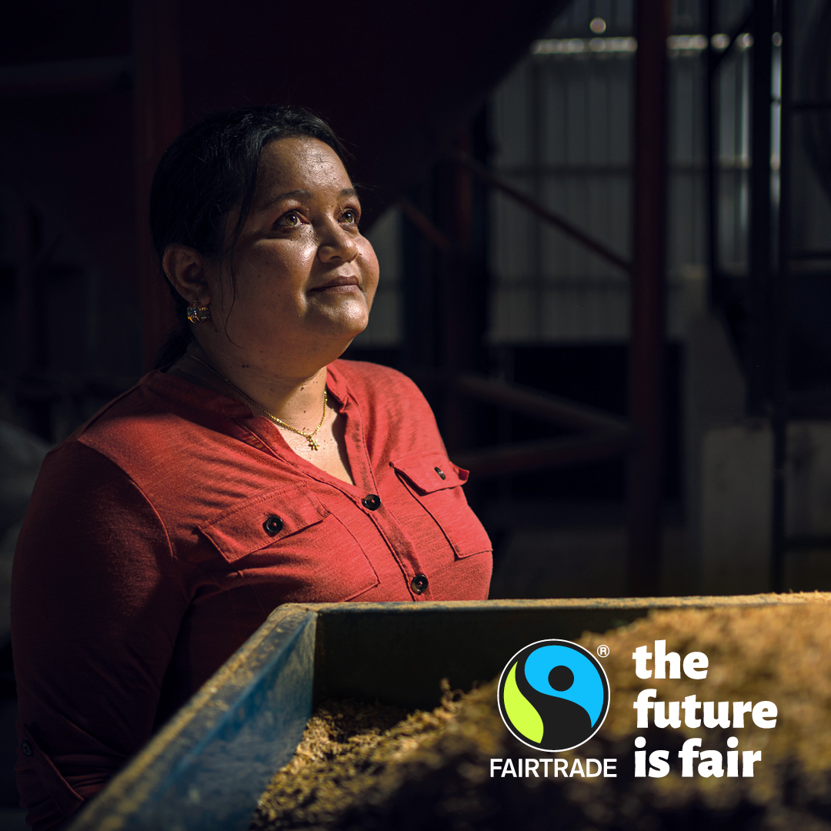
The Future is Fair
"Women deserve power and ownership."
Odessa Michelle Grant, Fairtrade coffee farmer, Honduras. As her community rebuilt after a hurricane, Odessa has used Fairtrade to shake up traditional land ownership, so women have more rights and power to manage land and resources.
Notes:
Emilia’s story shows us that the future is challenging, but also that the future can be fair.
We have the potential in all the little things we do to help build a fairer future. We can’t solve the cost of living crisis or the climate emergency alone. Just as we can’t fix a global trade system built on colonialism and centuries of racist exploitation by ourselves.
But when we choose Fairtrade we are choosing more power and resources in the hands of women like Emilia, and women like Odessa. Odessa is another Fairtrade farmer who has driven positive change in her community.
"Women deserve power and ownership."
Odessa Michelle Grant, Fairtrade coffee farmer, Honduras. As her community rebuilt after a hurricane, Odessa has used Fairtrade to shake up traditional land ownership, so women have more rights and power to manage land and resources.
Odessa was able to use Fairtrade to drive this change for two reasons. Gender equality, like environmental protection and the ability to earn a decent living, is a key part of Fairtrade. Farmers who commit to Fairtrade commit to the principle of gender equality.
But as important is the extra income Fairtrade offered Odessa and her community. This helped them rebuild, and rebuild well, after the disaster of the Hurricane.

Slide 24
The Future is Fair
The very future of food and the communities who grow it are in danger. But a fairer future is possible
If we take action now – and back women like Odessa building that fairer future.
Choose Fairtrade to back farmers building sustainable livelihoods and driving positive change in their communities.
Go one step further by becoming part of our global Fairtrade campaigning community.
Notes:
With more power – and more money – in their hands, farmers like Odessa and Emilia around the world can help build that fairer future.
If enough of us take action now, we make sure they have the resources to go further and go faster.
We can start by making that small switch to Fairtrade, to support producers protecting the future of some of our most-loved food and the planet.
Then we can go one step further by joining our global Fairtrade campaigning community. Visit the Fairtrade Foundation website, sign up to get emails or follow the social media channels to find out more.

Slide 25



Take action
Choose Fairtrade whenever you can. Choose to invest in the farmers doing amazing work to secure a sustainable future for food.
Spread the word. If more of us choose Fairtrade we can make an even bigger difference. Visit our social media channels, including Facebook, Twitter and Instagram, or sign up for emails by visiting fairtrade.org.uk/join
Make a Community Declaration of Solidarity. In every single UK constituency, Fairtrade supporters have started a Community Declaration of Solidarity for farmers taking on the climate crisis. Visit Fairtrade.org.uk/ClimateJustice to join them today.
Notes:
So let’s end with three practical things you can do to take action
Choose Fairtrade whenever you can. Choose to invest in the farmers doing amazing work to secure a sustainable future for food.
Spread the word. If more of us choose Fairtrade we can make an even bigger difference. Visit our social media channels, including Facebook, Twitter and Instagram, or sign up for emails by visiting fairtrade.org.uk/join
Make a Community Declaration of Solidarity. In every single UK constituency, Fairtrade supporters have started a Community Declaration of Solidarity for farmers taking on the climate crisis. Visit Fairtrade.org.uk/ClimateJustice to join them today.

Slide 26

Thanks!
Visit www.fairtrade.org.uk to find out more
Sources for all statistics and facts in this presentation are available on the Resource Library section of our website.
Notes:
Thank you very much for listening today! Visit the Fairtrade Foundation website or follow their social media channels to find out more.
Hope you have a great Fairtrade Fortnight and please keep choosing Fairtrade!

