Slide 1
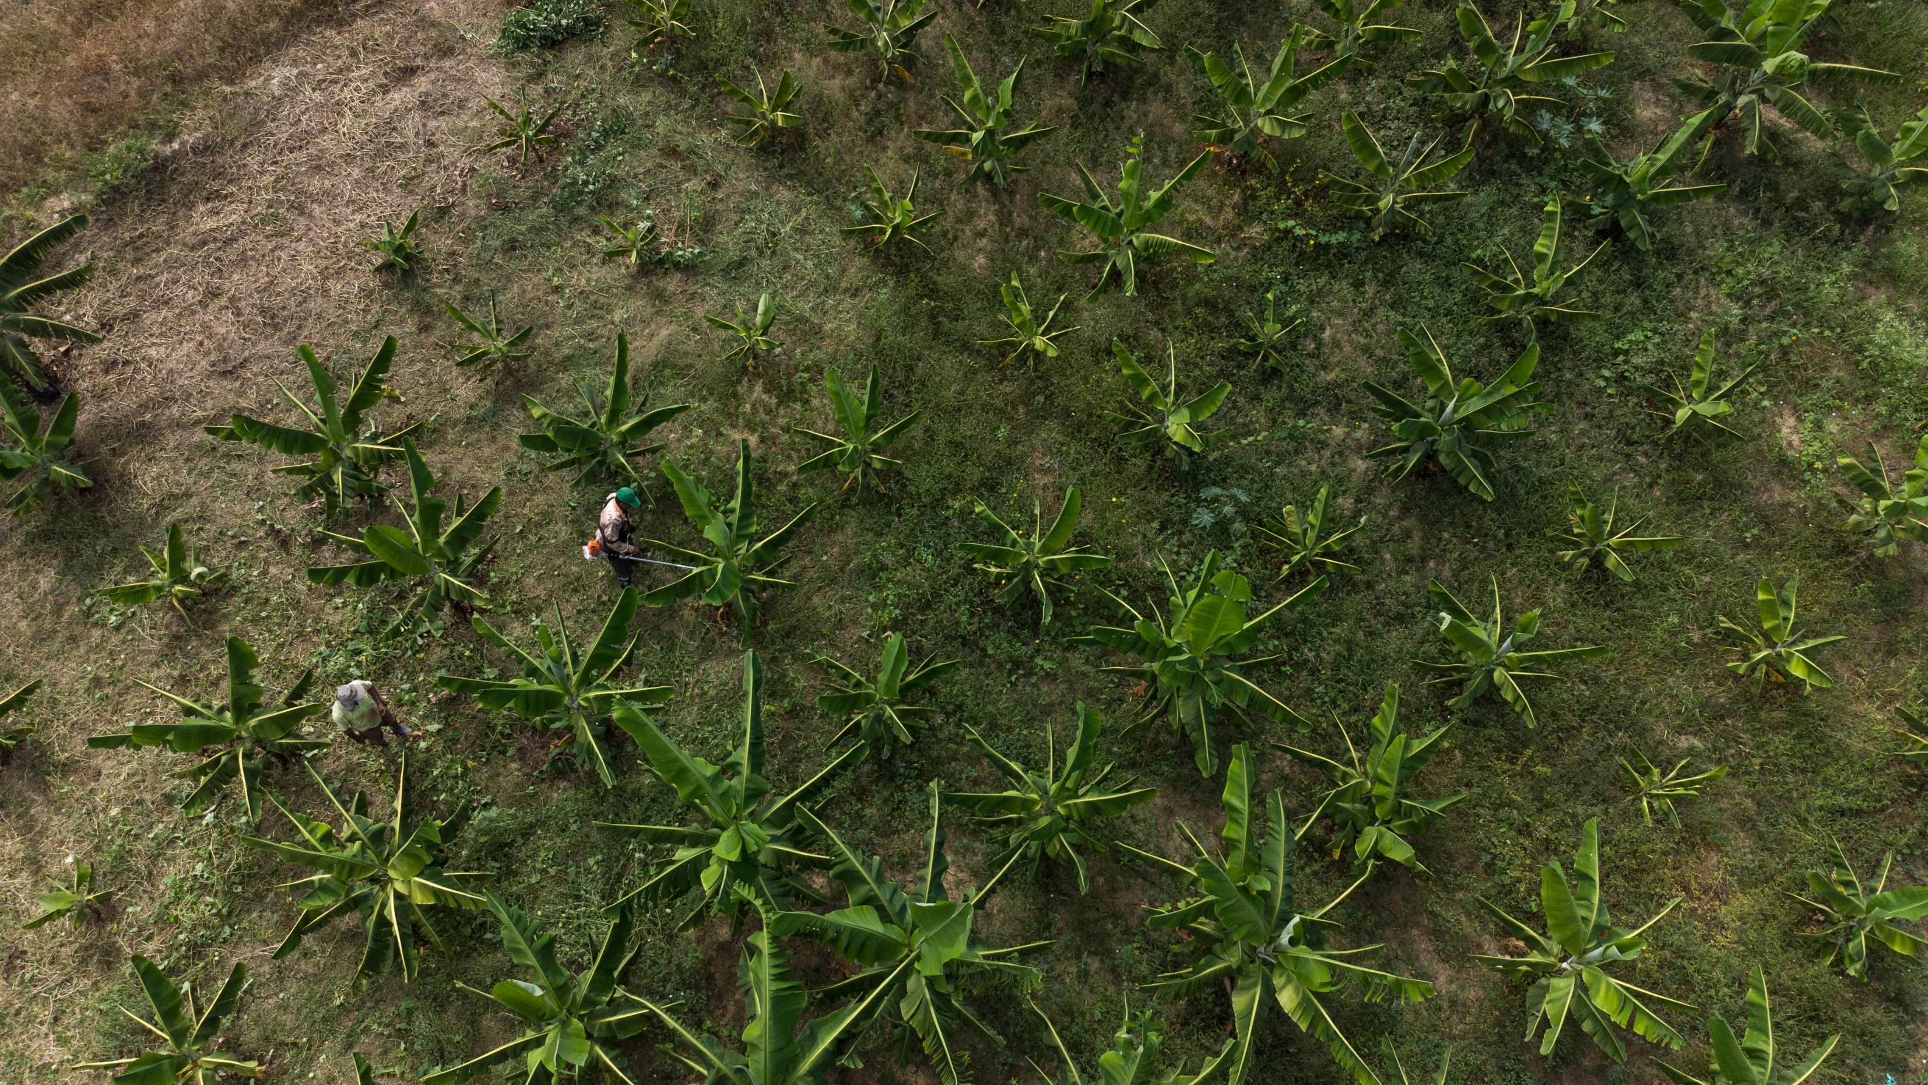

Preparing for your audit
Participant support for getting ready for the FTUC Award auditing process

Slide 2

Welcome
Elena Fernandez-Lee, Education Campaign Manager
Sarah Hazlehurst, Campaign Manager
Imogen Suett, Education Campaign volunteer

Slide 3
Agenda
Timeline
Completing the toolkit
Recruiting auditors
The auditing process
Top tips from an auditor
Award completion
Group discussion/Q&A

Slide 4


Timeline
All the key dates

Slide 5
Auditing timings
19 May – 13 June
Audit moderation
Auditor recruitment comms pack goes out 6 March
22 April Student auditor recruitment deadline
23 June
Celebration event
16 May
Audits completed
February 25
March 25
April 25
May 25
June 25
30 April/1 May
Auditor training days
27 February
Preparing for your audit webinar/ auditor recruitment pack live on website
16 June
Final reports issued
11 April
Toolkit submission deadline
1 May
Audit meetings

Slide 6

Completing the toolkit
A guide to completing the toolkit

Slide 7
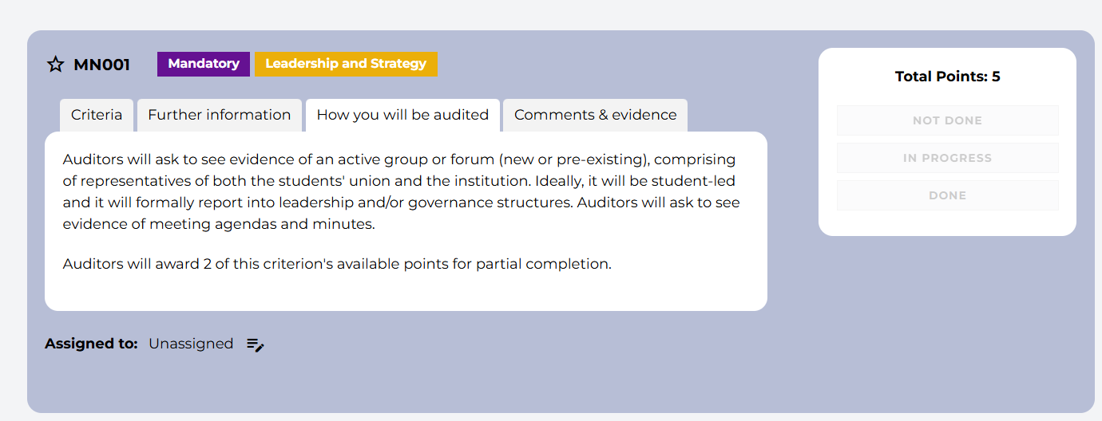
Criteria

Slide 8
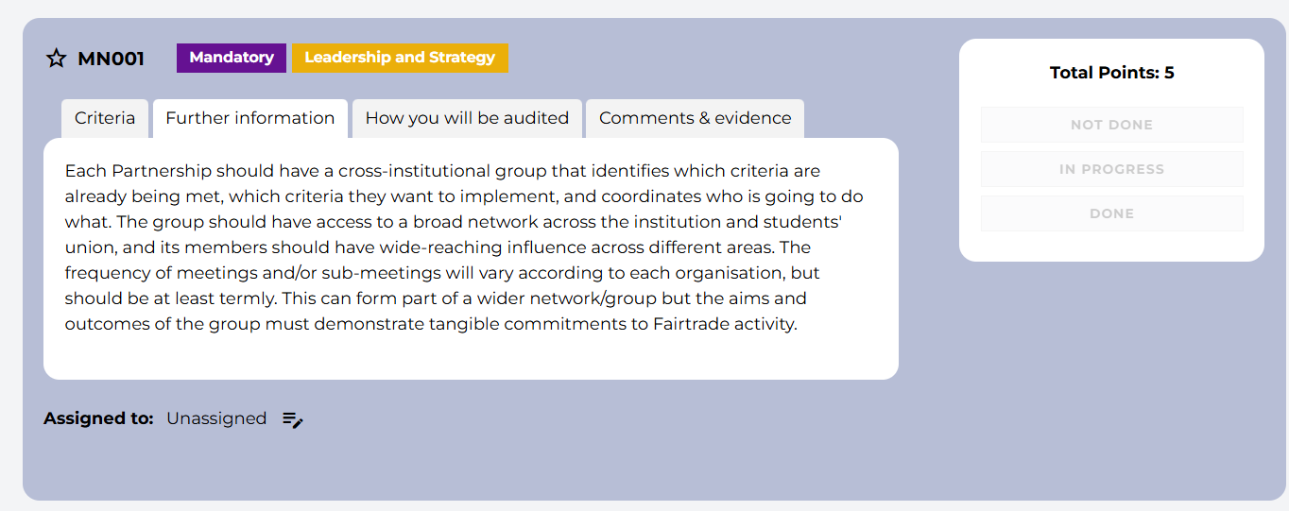
Further information

Slide 9
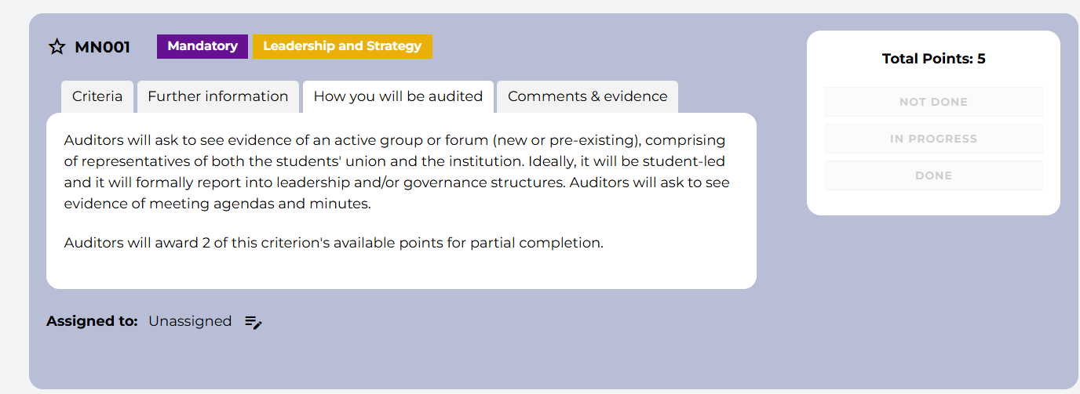
How you will be audited

Slide 10
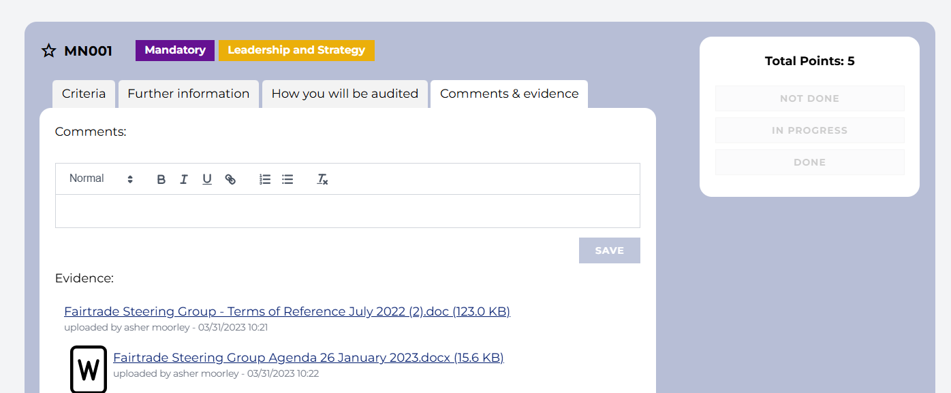
Comments and evidence

Slide 11

Recruiting auditors

Slide 12

Student auditor recruitment process:
Institutions are now recruiting their own auditors.
How many students you will need depends on how many criteria you have completed/submitted. You will need 1 auditor per 10 criteria and 2 minimum.
We will provide institutions with a comms package to aid you with student recruitment. This will include:
Text templates to put in email/newsletter to students
Graphics for social media
An auditor recruitment Microsoft form template link

Slide 13
Student auditor recruitment process:
We will create a Microsoft Form for institutions to share with students when they advertise the auditor opportunity, to include:
contact details
where and what they study
why they are interested in the opportunity
making sure they are available on 30th April and 1st May

Slide 14
Student auditor recruitment process:
Institutions should advertise the opportunity as an 8-hour commitment and make it clear that the student must be available on 30th April and also for the morning of the 1st May at a minimum to participate.
For the auditor training on 30th April and 1st May we will share a Teams or Zoom link and ask them to share this with their students.
For the audit meetings on the afternoon of 1st May you will need to organise calendar invites and either book a room or space or have a link for an online meeting.

Slide 15

Audit process

Slide 16
Audits process:
Morning of 30th April for 2-hour training, then afternoon for going through the institution's submission and adding in comments, for 2 hours .
Morning of 1st May to complete going through the institution's submission for 2 hours, then afternoon for audit meetings. The institution will arrange in advance of the training a time they are meeting with their students for an hour either on the afternoon of the 1st May, or another day before 9th May if they really have no availability for that day.
The auditors will then have 1 hour after their meeting to write up any final comments and submit their audit on the toolkit platform.

Slide 17

Top tips from an auditor

Slide 18
Plan in ADVANCE.
Communicate effectively.
Network!

Slide 19

Award completion

Slide 20
What happens when audits are complete?
Audit moderation
Ideally to be submitted on 1st May, but the final deadline for students to submit audits is 16 May, and these are then passed onto the Fairtrade and SOS-UK team to moderate between 19 May- 16 June. During this time, our team will review your marks and comments and make sure that there is fair marking across the board. We will also create your report and certificates during this time.
Receiving your reports and certificates (plus new wooden awards!)
We aim to release your results along with reports and certificates via email to you directly on 16th June. We will also put out a press release on this day will the full cohorts' results.
Did you know that this is the first year that we have offered wooden awards?! These cost £30+VAT and are delivered directly to your listed address. Opt in now!

Slide 21
What happens when audits are complete?
Celebration event
On 23rd June we will hold an online Celebration event! Please come along and celebrate your Fairtrade successes with us.
Sign up for your next cohort straight away!
In June we will share the link for you to express interest in signing up to the next cohort.
Fairtrade Fortnight 2025
Fairtrade Fortnight 2025 will take place 22 September – 05 October and there’s no better time to start planning your activities now!

Slide 22

Thanks!
Any questions?

