Slide 2
In this toolkit you’ll find:
Section 1
03
Overview of the Brew it Fair campaign
Section 2
08
Campaign Action Guide
Section 3
13
Campaign Resources

Slide 3
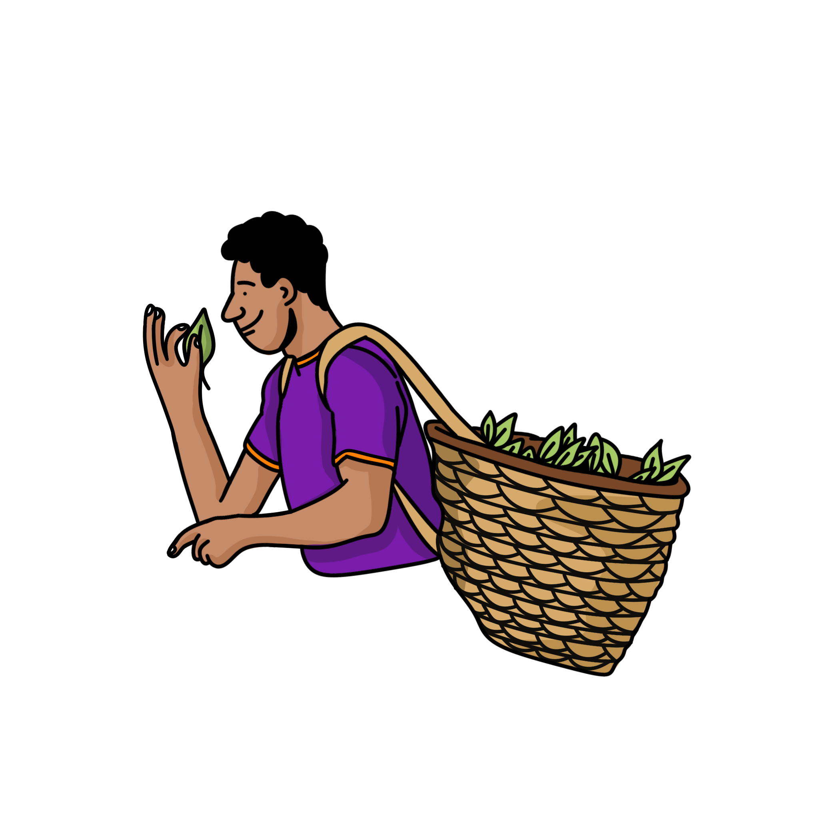

Slide 4
Fairtrade Manifesto
With the world in a tailspin,
fairness isn’t a given.
But the power to get there is in our hands.
Together, our actions can have a positive impact
on real people’s lives.
Fairer pay. Fairer treatment. Fairer futures.
That’s Fairtrade.
It’s not just a label – it’s a movement.
So, whatever you do,
and however, you do it:
Do it fair.
Notes:
Keep in messaging

Slide 5
What is the Brew it Fair Campaign?
Tea is more than just Britain’s favourite drink- it's a daily ritual that unites millions across the country. But behind every cup lies an unfair global trading system where the people who grow and pick our tea face low wages, poor conditions, and an unequal share of power.
Our new Brew it Fair campaign calls on UK consumers, businesses, and the government to act now. Together, Governments, businesses and communities can work alongside tea growers and pickers. We can raise low tea prices, increase pay and demand human rights for the people behind the tea we drink.
Together, we can "Brew it Fair" and stand with the people behind the tea we drink.
Notes:
Keep in messaging

Slide 6
Campaign Key Messages
Tea is the world’s most popular drink, in Britain alone we drink over 100 million cups of tea every day. The comfort of a cup of tea connects people of all backgrounds across the UK. From the ritual of an afternoon tea to the simplicity of a builder’s brew, the great British cuppa is a longstanding part of our national identity. The tea we drink also has the potential to contribute to rural development, water access, improve education outcomes, empower women and – ultimately – change lives.
But right now, too little of the money in the tea industry goes back to the people who grow and pick our tea. As tea drinkers, we have become used to paying very little for our cup of tea. The price of an average tea bag today is just around two or three pence, while behind that cup, the cost to grow and pick our tea is increasing.
Notes:
Keep in messaging

Slide 7
Campaign Key Messages
A small number of companies dominate the tea industry from crop to cup. But, despite high levels of unstable work, low incomes and wages, gender discrimination and unsafe working conditions, most businesses are still not taking responsibility for the impact their purchasing practices have on the people in their supply chains. Urgent action is needed to support the people at the end of these supply chains to create positive change for themselves, their communities and our shared environment.
Today, the tea industry has many complex and deeply entrenched issues, driven by an unequal trading system where the power remains in the hands of the few. And it will require a collective effort to change the future for the people behind Britain’s favourite drink.
Together, Governments, businesses and communities can work alongside tea growers and pickers. We can raise low tea prices, increase pay and demand human rights for the people behind the tea we drink.
Notes:
Keep in messaging

Slide 8
Notes:
Action guide

Slide 9
Do it Fair. Brew it Fair.
Our focus across all of 2025: Brew it Fair
This year, we’re inviting communities to take a closer look at one of Britain’s most beloved rituals – the humble cup of tea – and make a swap that supports fairness, dignity, and sustainability for those who grow it.
By choosing Fairtrade tea and calling for systemic change in how tea is traded, we can collectively help protect nature, support communities overseas, and ensure the people behind our tea are paid fairly, treated with respect, and able to adapt to climate change. It’s a small act with a powerful ripple effect.
How you can get involved in 2025:
Encourage your community to sign the petition calling on the UK Government to introduce a new law that protects the rights of tea workers and farmers.
Ask your MP to support the campaign.
Plan tea-themed events using our ideas and resources during Fairtrade Fortnight.
Use the Brew it Fair branding and social media graphics to share the message widely.
Together, let’s brew it fair – for people, planet, and the future.

Slide 10
Sign the Brew it Fair petition
Ask the UK government to Brew it Fair and stand with the people behind the tea we drink
We are calling on the UK government to:
Introduce a UK law on Human Rights and Environmental Due Diligence (HREDD) that is centred on the needs of overseas farmers and workers. This legislation must focus on supporting living incomes and living wages, ensuring that the costs and burdens of proof and compliance are not passed onto those farmers and workers, and addressing unsustainable purchasing practices, pricing structures and business models which undermine progress.
Collaborate with businesses to change the future of the tea sector.
Honour the UK’s International Climate Finance commitment to ensure aid and climate funds can support the people behind the tea we drink to adapt and build resilience to climate change.
Sign the petition now and grow our tea-total!

Slide 11
Ask your MP to support Brew it Fair
Ask your MP to support the Brew it Fair Early Day Motion
Martin Rhodes MP, Chair of the All-Party Parliamentary Group for Fairtrade, has tabled an Early Day Motion for International Tea Day, supporting the petition.
You will receive an email with a quick and easy way of asking your MP to sign on to the Earley Day Motion and show their support for Brewing it Fair in June.
What is an Early Day Motion? Parliamentarians in the UK can table a motion within the Westminster parliamentary system. By attracting the signatures of other MPs, Early Day Motions can be used to demonstrate the level of parliamentary support for a particular cause or point of view. Parliamentary support will highlight the need for the UK government to brew it fair and stand with the people behind the tea we drink.

Slide 12
Fairtrade Fortnight
During Fairtrade Fortnight 22 September – 05 October support Brew it Fair by running a local event!
Mark your calendars for Fairtrade Fortnight! From 22 September – 05 October, Fairtrade supporters nationwide will come together to celebrate the ongoing impact of the movement, highlight the challenges the people who pick and grow our tea face every day, and continue to push their communities and MPs to take action.
Campaigners will receive a Fairtrade Fortnight toolkit and opportunity to order an event pack later in 2025

Slide 13
Notes:
resources

Slide 14
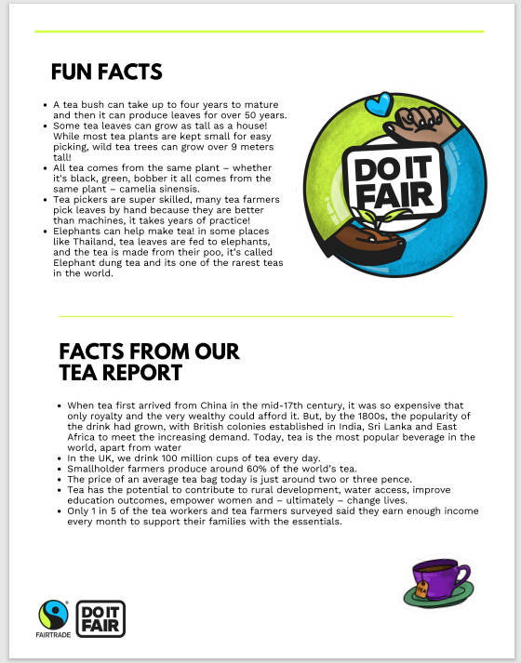
We have developed resources for you to take the Brew it Fair campaign into your local community events and talks. You can access all these resources here on the resource library.
Education presentation & script
Community presentation & script
Tea quiz
Tea fact file
Brew it Fair: Stories from people behind your tea
Download the campaigner resources here

Slide 15
We also have a selection of social media resources that you can use to spread the Brew it Fair campaign messages online as well as promote your own events including ready to go social posts, webpage banners and zoom backgrounds as well as digital stickers to personalise your own materials.
Download the digital resources here

Slide 16
Use this 2000 x 800 template for website banners, ideal for homepage headers or Facebook group banners.
Download website banners here

Slide 17
Use this 9:16 portrait template for social media stories on platforms like Instagram, Facebook, or TikTok.
Download portrait social media posts for Instagram stories here

Slide 18
Use this 1:1 square template for social media posts on platforms like Instagram, Facebook, and LinkedIn.
Download square social media posts here

Slide 19
Use this 1920x1080 Zoom background for virtual meetings or webinars.
Download Zoom backgrounds here

Slide 20
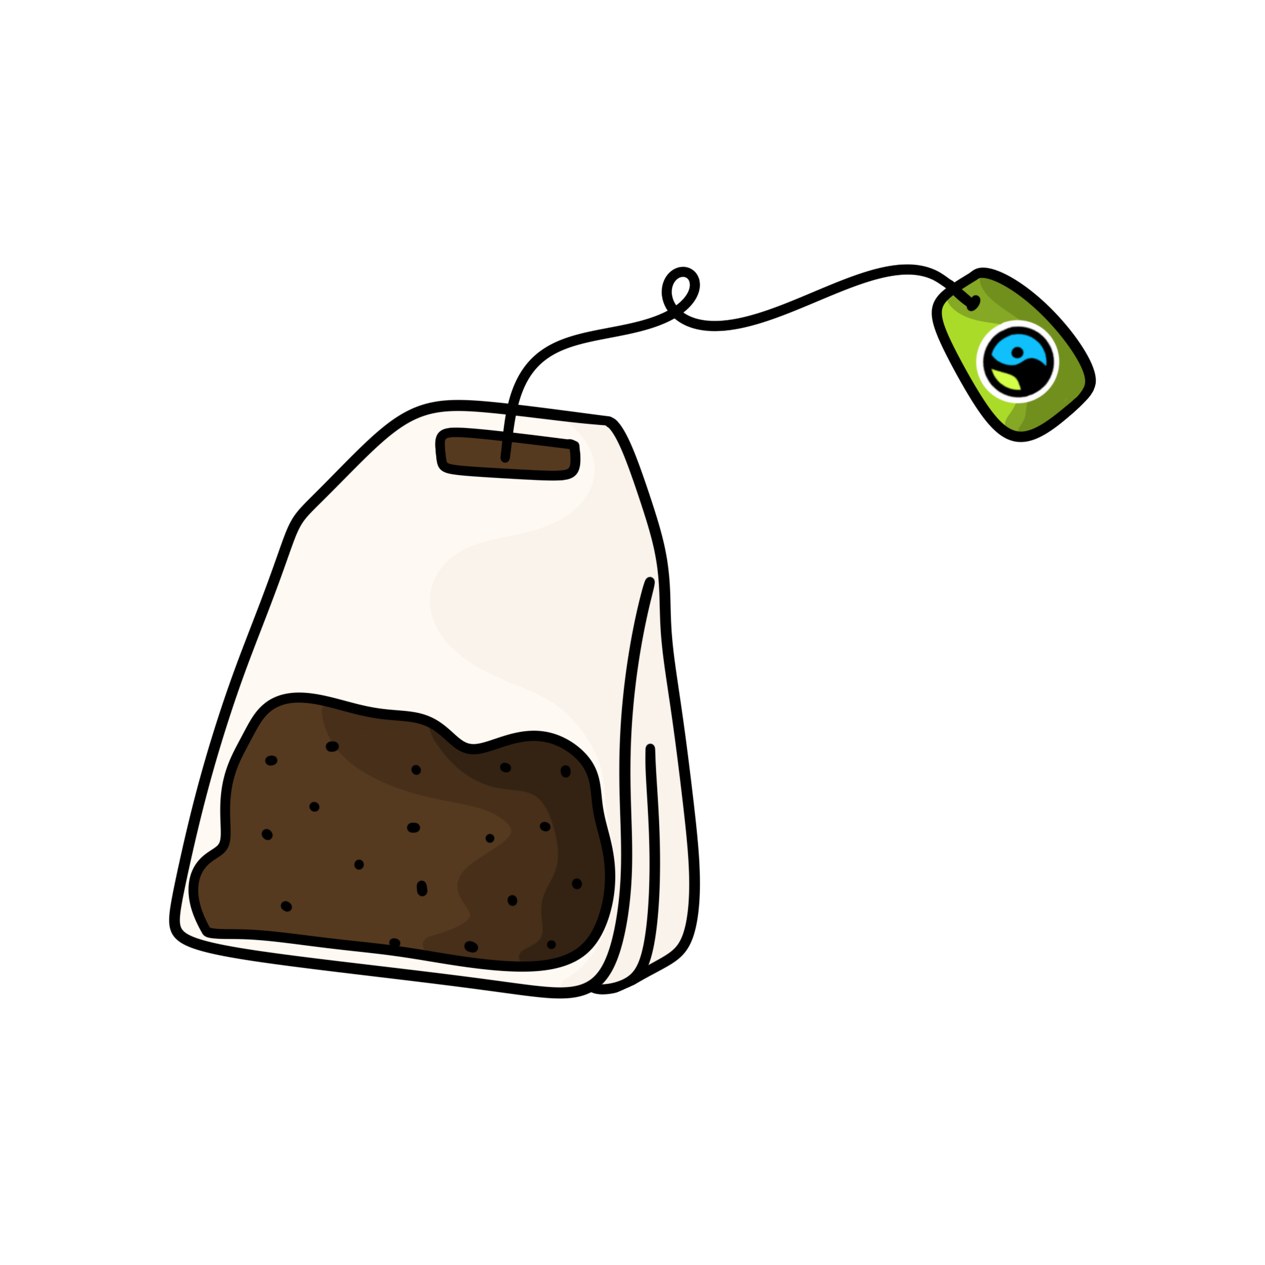
These illustrations can be used across all communications or printed materials to add fun, eye catching visuals to your campaign materials
Bananas
Coffee
Flowers
Wine & Beers
Chocolate
Cotton
Download stickers here
Tea

Slide 21
Circularity
Shopper
Education
Tea Picking
Farmer
Tea cup
Activism
Tea Farmer
Justice
Health
Water Scarcity
Fairtrade Supporter
Tea Plant
Fairtrade Badge
Download stickers here

Slide 22
Heart
Wealth
Compassion
Sun
Tea Drinkers
Globe
Water
Literacy
Lightbulb
Brewing
Gender Equality
Starburst
Download stickers here

Slide 23
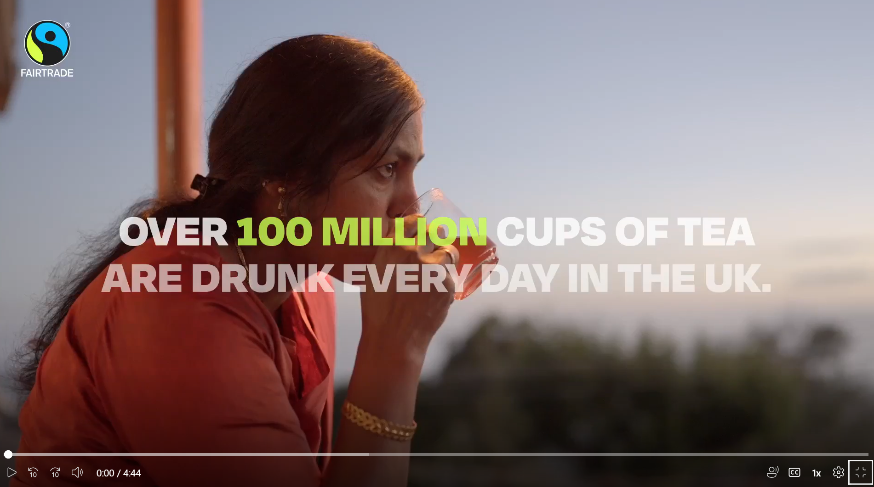
Campaign Film
Watch the film at this link https://vimeo.com/1086434745?share=copy
Notes:
Keep in messaging

Slide 24
For any questions related to this document, please get in touch with the campaigns team: hello@fairtrade.org.uk

