Slide 1
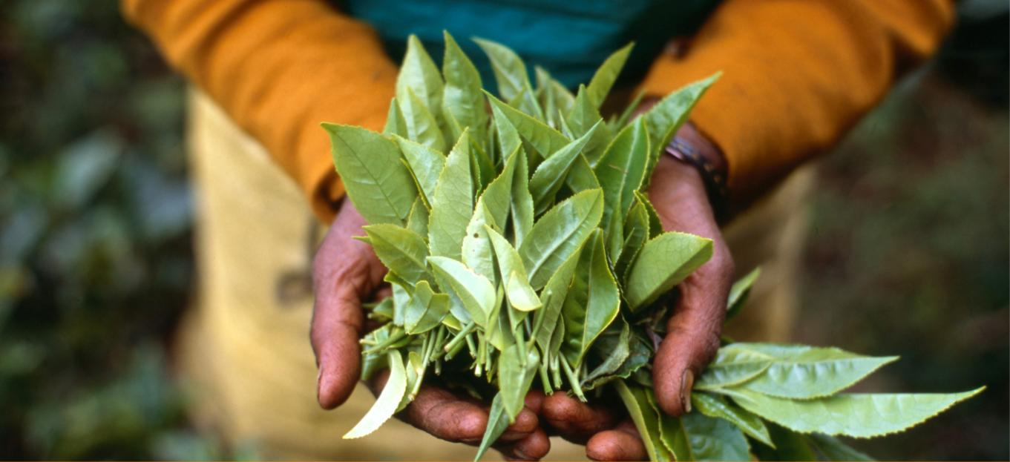
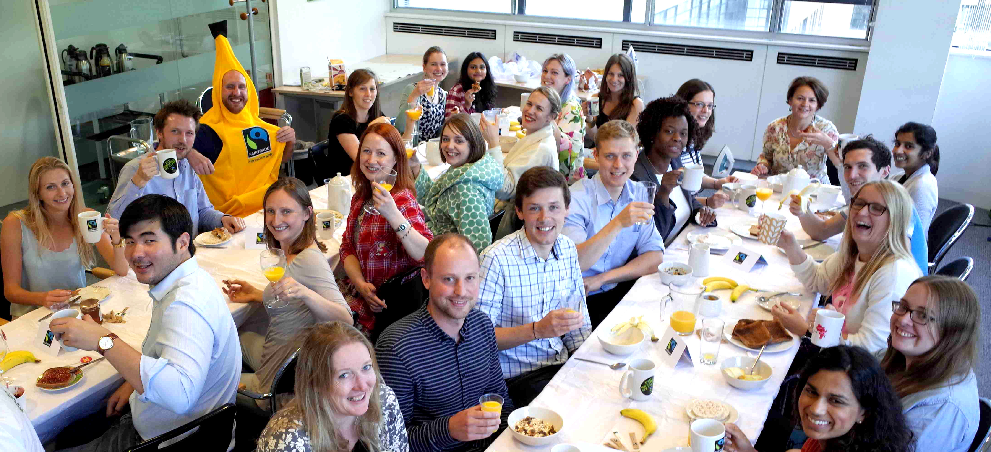


Notes:
Notes: This is a presentation to help Fairtrade campaigners and supporters connect with workplaces – to encourage them to procure and serve Fairtrade to employees and visitors. You can change and adapt the slides as you see fit. The notes are guidance and are not necessarily to be read verbatim, but to help guide your talk. The presentation will take approximately fifteen minutes to read through, and longer if you choose to show the video or have discussion points. We recommend timing yourself reading through the presentation a few times to get the timing and contents right. Good luck!
Introduce yourself – who are you and who do you represent?
There are a number of simple ways that your workplace can choose to engage with Fairtrade. I’m here today to talk you through what Fairtrade is and how you can support it.

Slide 2

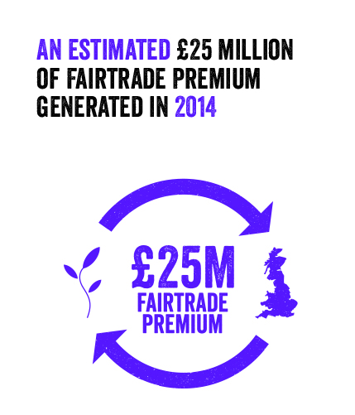
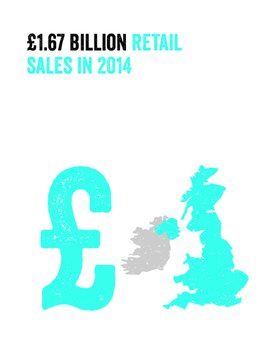
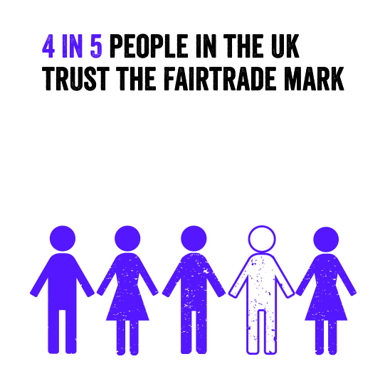
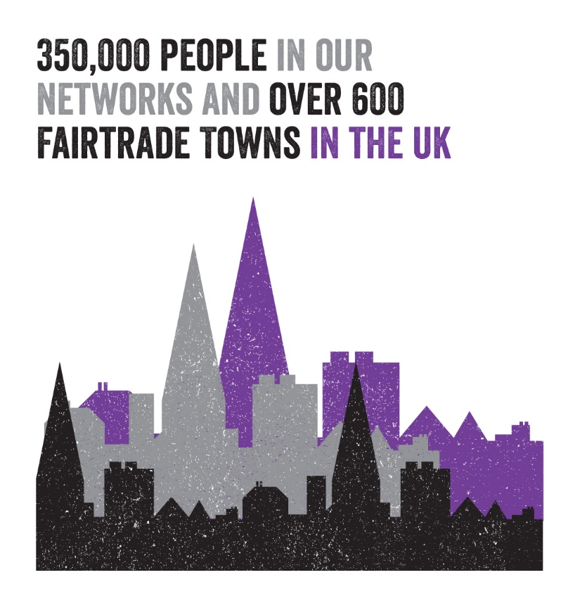

Notes:
The Fairtrade movement is a global one, made up of organisations, producers, supporters and consumers across the globe. In the UK, it’s represented by the Fairtrade Foundation, an independent not-for-profit organisation that licenses use of the FAIRTRADE Mark, works with businesses to improve supply chains and campaigns to make trade fair.
The UK is the biggest market for Fairtrade products in the world and the Fairtrade Foundation works with over 400 companies of all shapes and sizes, from brands to retailers and contract caterers.
A network of thousands of Fairtrade campaigners, from Fairtrade Towns and Cities to schools, universities and places of worship, promotes Fairtrade products and values across the UK. To be a Fairtrade Town is to engage in all areas of the community to encourage support and purchase of Fairtrade – from councils to local retailers, from media outlets to schools, churches and community groups. They(/we) hold events, promote their activities and generally try to ensure that Fairtrade runs through the heart of the community.
Additionally, in this slide you may wish to:
Explain the influence/growth of Fairtrade in your community as well as nationally.
Talk about other businesses that use/support Fairtrade in the area

Slide 3

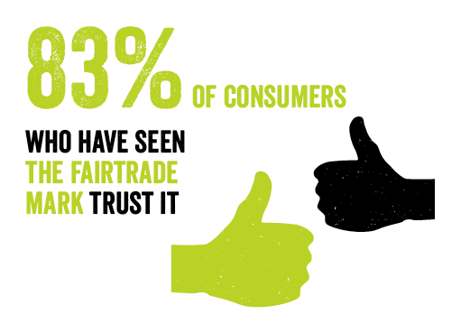
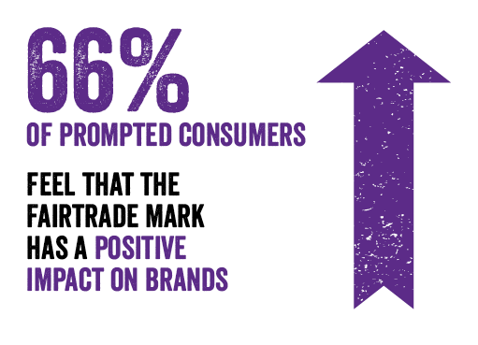
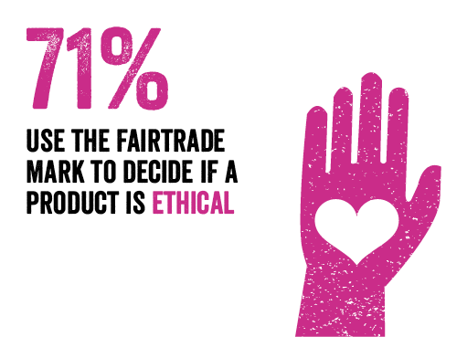
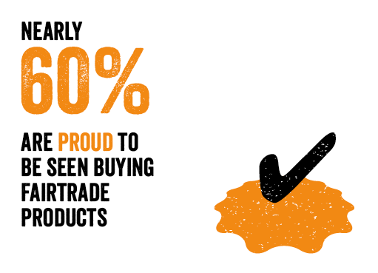
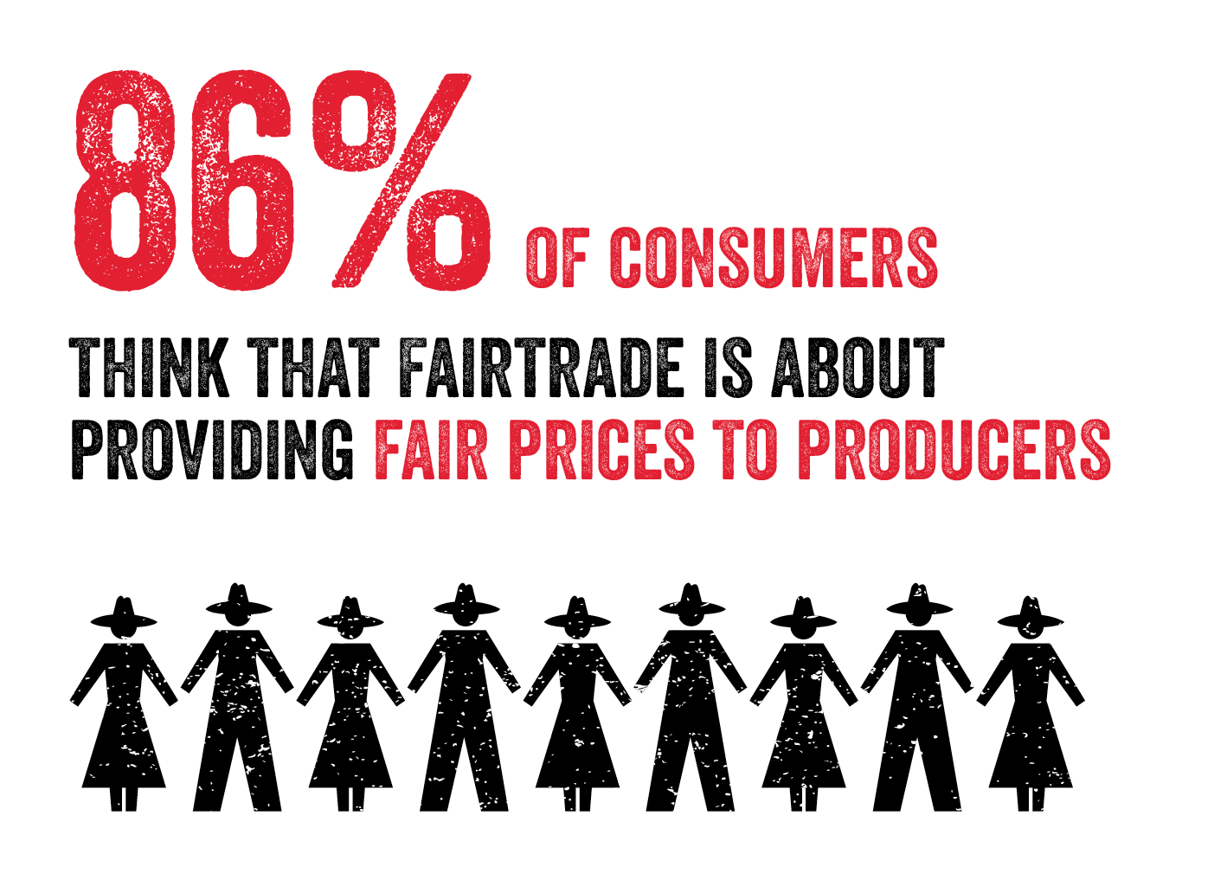
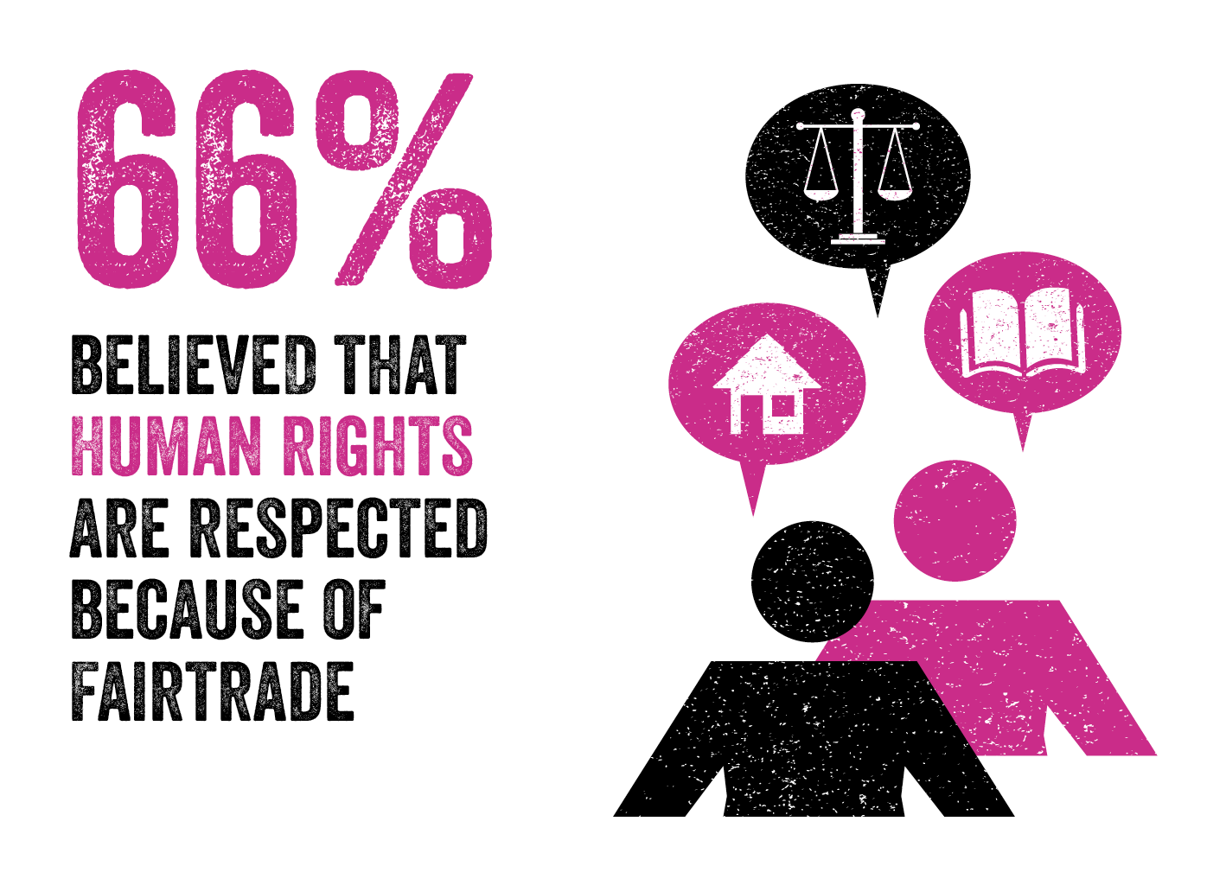
Notes:
The FAIRTRADE Mark remains the most recognisable ethical mark in the UK, and over the past 20 years has been firmly embedded within people’s awareness and understanding.
Over 90% of people have seen the Mark before and over 80% of people trust it as a credible certifier.
In addition to recognising the Mark, consumers also understand what it means – 86% recognise that it is about providing a fair price for producers, and 66% believing that human rights were respected through adhering to the Fairtrade standards.
Over the next five years, part of Fairtrade’s strategy is to deepen this awareness, and to ensure that the key values and principles of Fairtrade resonate with consumers, especially students, who are particularly engaged with Fairtrade.
By serving Fairtrade tea, coffee and sugar to your staff and visitors you are demonstrating your ethical credentials as a business. I’ll explain more about exactly what Fairtrade does and the impact that it makes moving forward…

Slide 4

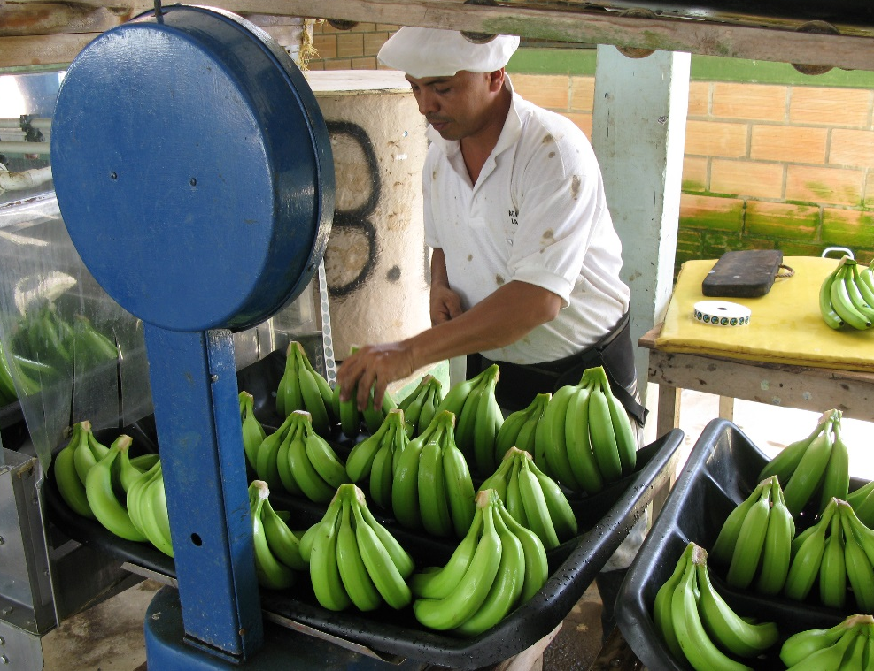

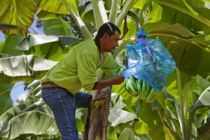
Unique independent certification mark
Fairtrade Minimum Price
Additional Fairtrade Premium
Decent working conditions and fair terms of trade
Supporting the development of thriving farming and worker communities
Empowering farmers through trade rather than aid
Notes:
Fairtrade offers a simple solution to consumers’ ethical needs that can be part of their every day lives, and delivers meaningful change to farmers.
When you see the FAIRTRADE Mark, it means that the product has been independently certified to make sure producers are getting a better deal from what they sell.
The producer organisations have received a stable price that aims to cover the average costs of sustainably producing their crop.
In addition to the basic price, farmers and workers have the opportunity to improve their lives through the Fairtrade Premium. They can use this money any way they like to improve their own organisations, or invest in their community. Farmers and workers decide democratically what these projects should be.
Fairtrade standards aim to protect and improve the environment, and promote sustainable agricultural practices. With the extra income that farmers receive from Fairtrade, they can also invest in their own environmental projects, such as recycling, tree planting, clean water programmes. Some farmers are also using money from Fairtrade to convert to organic farming methods.
Small farmers gain a stronger position in world markets by working together in a cooperative. Fairtrade supports small farmers in building up their own organisations, and helping them to compete in a vicious market place.
With Fairtrade, we can feel a closer link with people at the other end of the supply chain who grow the products we buy.
This alternative system of trade is unique, and there are many elements that make Fairtrade special…

Slide 5

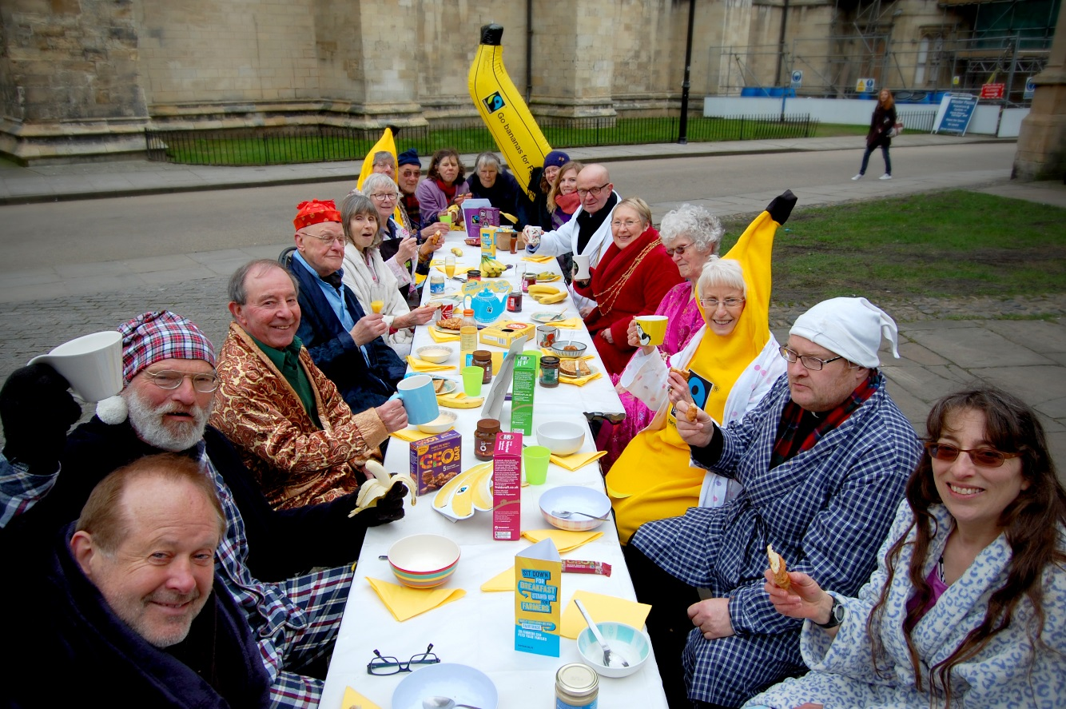
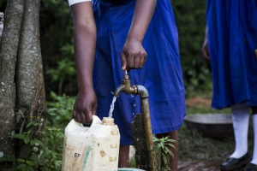
Grassroots movement
Trust and awareness
50% producer owned
Assistance to farmers
Availability
Notes:
Fairtrade connects with citizens around the world and has strong grassroots support in the UK. There are over 1800 Fair Trade Towns internationally, campaigning for fairer trade and convincing businesses and consumers of the importance of choosing ethically certified options.
Fairtrade has top awareness and trust levels making it a valuable business partner – trust is rooted in face to face recommendation and community level support for Fairtrade across the UK
Producers own 50% of the Fairtrade system and are a key part of decision making – producers shape the Fairtrade standards and future strategy, and have 50% decision making at the highest level of the Fairtrade system’s governance
Fairtrade provides access to sourcing funds, pre-financing and partnership facilitation
Fairtrade certified products are more numerous and span more categories than any other similar certification schemes, making it a lifestyle choice for consumers
As well as benefiting producer communities, Fairtrade is also a sustainable choice for the environment – as we’ll explore next…

Slide 6

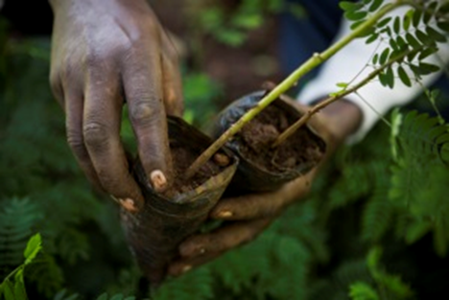
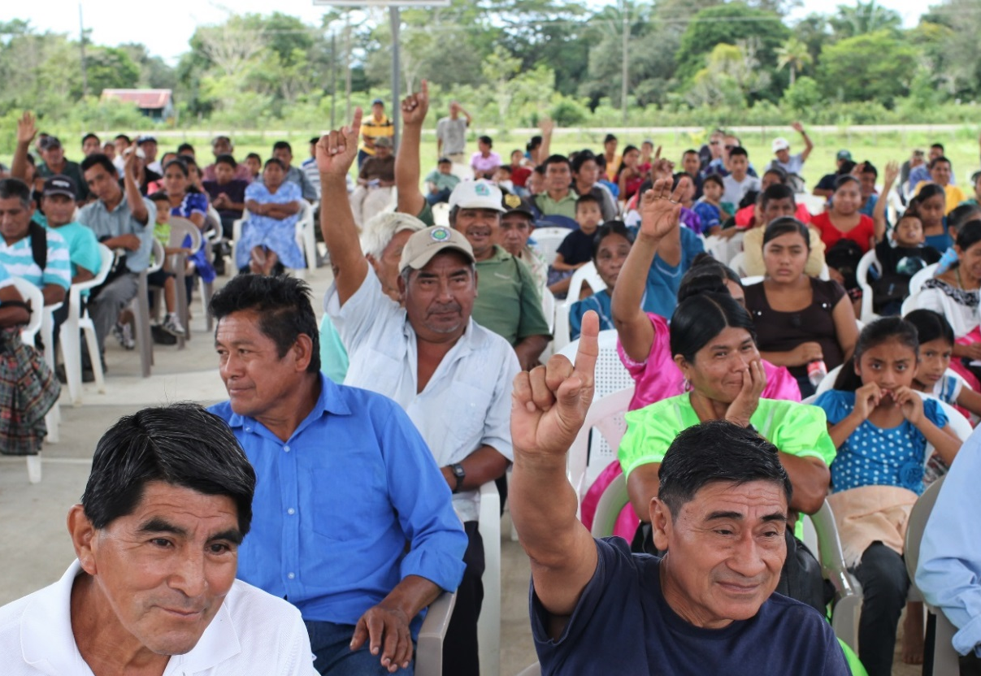
Improving standards of living
Protecting the environment
Building stronger organisations
Improving productivity and quality
Notes:
What do you think of when you hear the word sustainability? Climate change, the environment, and green living may immediately spring to mind, but stable incomes, gender equality and trade policies play an important structural role in ensuring sustainable livelihoods and environments.
For Fairtrade, sustainability means working not just on the environment, but also on existing economic practices and unequal structures to make sure that people’s needs today are met without compromising the needs of people in the future. Climate change is also a stark new expression of unfairness, since farming communities in some of the poorest countries are already suffering the effects of changing climate on their livelihoods, despite doing the least to cause it. Economy, society and the environment are inextricably linked.
Fairtrade addresses these three central themes, supporting farmers to be environmentally sustainable in multiple ways. Fairtrade-certified producers and traders need to meet environmental standards such as protecting the soil and water sources, managing waste, improving biodiversity and reducing carbon emissions. 55% of Fairtrade producers are also certified as organic.
Many Fairtrade-certified co-operatives invest their Fairtrade Premium in environmental projects to support their members to produce their crops in a more environmentally-friendly way. This not only improves their farms and the environment around them but it can mean they also produce more crops of better quality that can increase their income.
Potential discussion point: Why is (or should it be) sustainability important to your business?

Slide 7

Notes:
REMOVE THIS SLIDE IF YOU DON’T HAVE FACILITIES TO SHOW A VIDEO
Clicking on the image should take you through to YouTube- make sure you have speakers and are connected to the internet.

Slide 8


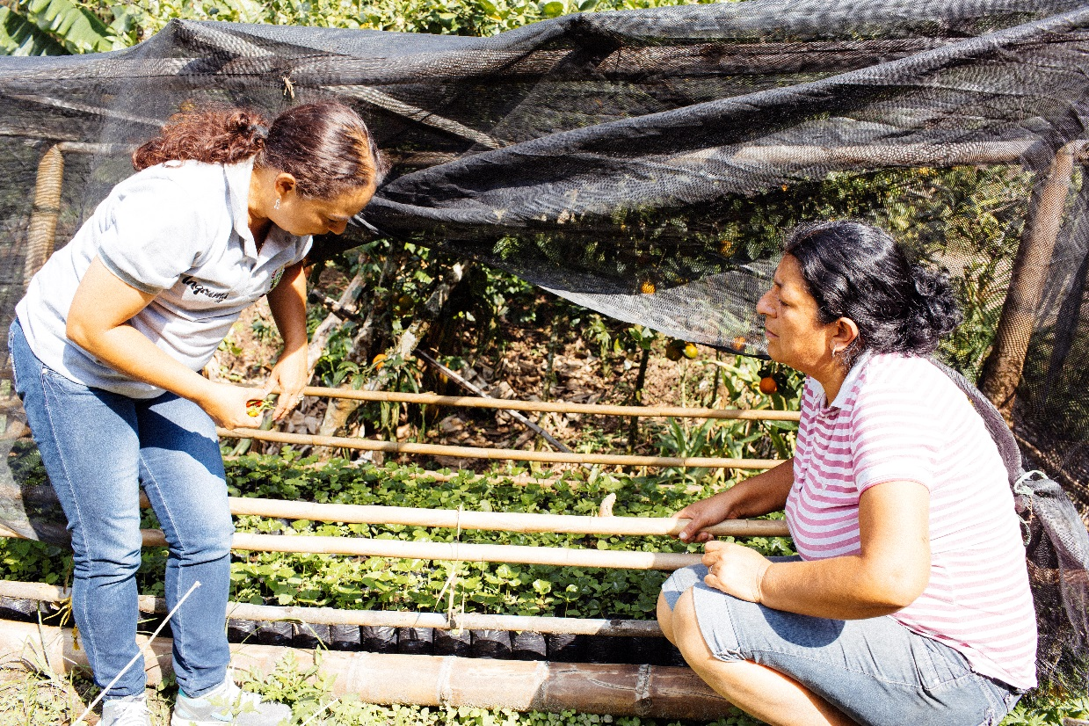
Asprocafé, coffee cooperative
Colombia
The Fairtrade Premium has been
invested in:
Water
Women’s empowerment
Coffee infrastructure
Local infrastructure
Health
Education
Economic credit
Notes:
The Fairtrade Foundation’s regular trips to meet producers and their robust Monitoring, Evaluation and Learning programme have proved that buying Fairtrade products really does support small scale farmers and workers who are marginalised from trade in a variety of ways.
The Fairtrade model has been described by a farmer as “much more than merely an environmental certification, it is the only and best ethical and social certification that really ensures social and environmental, ethical and economic impact, and therefore human impact’.
We’ve mentioned the Fairtrade Premium already, that extra sum of money (paid on top of the selling price) that farmers and workers invest in business or community projects of their choice. Take Asprocafe, a cooperative in Colombia, where farmers have been investing their Fairtrade Premium in a wide variety of projects to improve their business. For example:
Water – Upgrading the water infrastructure to supply more than 100 families with drinking water
Women – Setting up a revolving credit fund for women to spend on projects such as animal husbandry or dressmaking (which brings in additional revenues)
Infrastructure – Constructing de-pulping machinery and patios to dry their beans so they are ready for milling
Local infrastructure – Improving more than 37 miles of roads to rural communities
Health – Setting up a healthcare plan that covers medical emergencies and costs for 14,000 people
Education – Building classrooms for rural communities and providing free school meals
Economic credit – Offering farmers loans for machinery and livestock

Slide 9
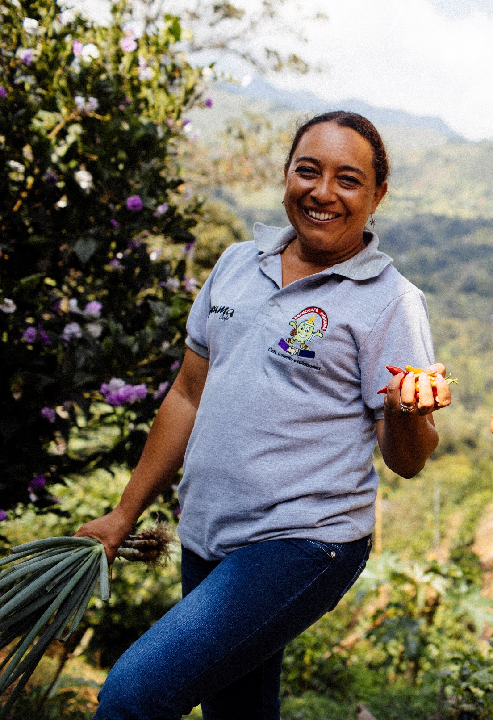
Luz Marina, Certification Manager
Asprocafé, coffee cooperative
Colombia
‘For me, Fairtrade is an opportunity to make dreams come true and improve living conditions for all the people involved in the production of coffee. Thanks to Fairtrade I was able to study and work for the wellbeing of my family and the small producers from my region.’
Notes:
Luz Marina works for Asprocafe, training farmers in a variety of ways to improve their crop and yield without damaging the environment. Luz Marina visited the UK during Fairtrade Fortnight 2016, the flagship campaign for the Fairtrade Foundation and campaigners, and travelled around speaking at events to show what a strong impact Fairtrade has made on her community. After studying (funded by the Fairtrade Premium), Luz Marina returned to the farm – a great success story as she now supports the community with her extra knowledge and expertise.
As well as being an important business decision for farmers, it’s a great choice for companies in the UK too…

Slide 10
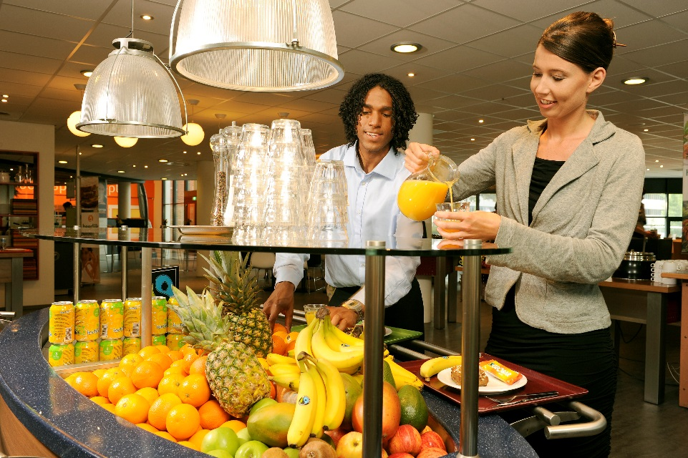
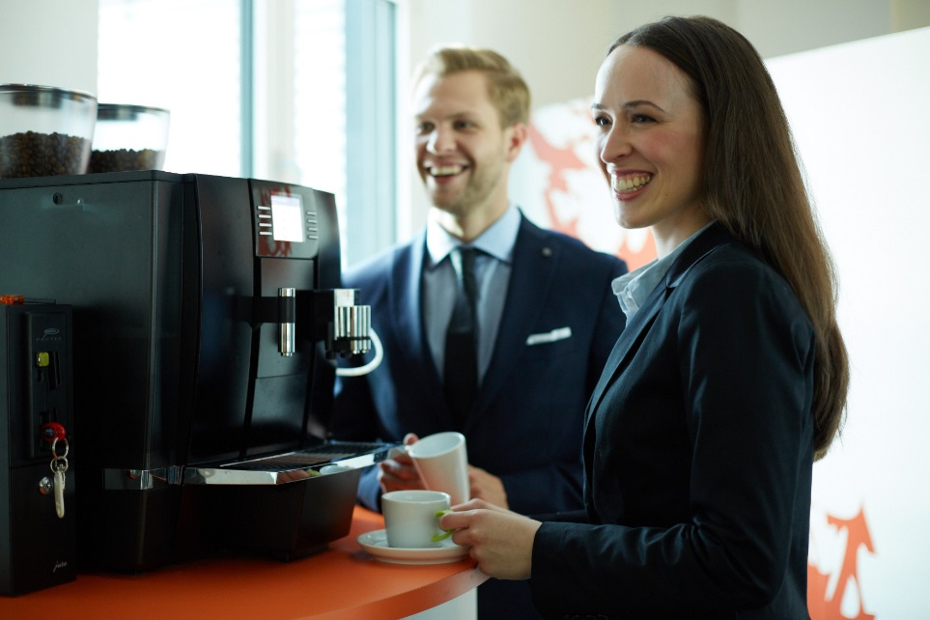
Corporate behaviour under scrutiny
Feel-good factor for staff
Clear demonstration of responsible business practice
Quality and cost
Meeting the ever-increasing consumer demand
Notes:
Corporate behaviour is under intense scrutiny by an increasingly discerning public who make ethical choices when spending their money. Integrating Fairtrade into your business by switching to Fairtrade purchasing is a highly effective way of showing your customers that you care, getting closer to your supply chain and potentially attracting more customers.
Switching to Fairtrade also adds a feel-good factor for staff.
Offering Fairtrade products to your staff and customers is a great way to demonstrate that you are a caring business as the FAIRTRADE Mark has a high level of recognition and consumer confidence.
Using Fairtrade products is as an ethical choice, but it’s also one of quality. The cost of these products may be no different (and the quality is often better) than products sourced under different standards.
Finally, there’s incredible consumer demand, especially from younger generations (particularly Millennials aged 21-35), who are:
Twice as likely to purchase a sustainable product as Generation X (35-49)
Four times as likely to purchase a sustainable product than Baby Boomers (50-64)

Slide 11

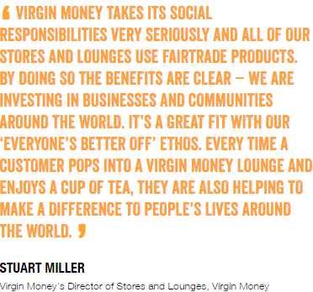


Notes:
Now here’s your chance to change the world. Your workplace could be making a difference to people’s lives by switching to Fairtrade. And you can celebrate your commitment by becoming a Fairtrade Workplace of World Changers, which is a new programme by the Fairtrade Foundation to recognise those workplaces serving tea, coffee and sugar to their guests and visitors. With every cup of tea and coffee and every spoonful of sugar you can make a difference, including adding to the Fairtrade Premium which farmers can invest in their businesses, and both farmers and workers in community projects like better health facilities and clean water.
Through signing up to the programme, approved workplaces gain:
More opportunities for staff engagement and team building
A publicly recognised certificate from the Fairtrade Foundation to showcase your Fairtrade commitment to staff and customers
A stronger profile in the local community (you’d be in good company – there are over 10,000 Fairtrade groups in the UK including towns, schools, faith groups and universities)
Evidence of your internal Corporate Social Responsibility (CSR) and sustainability activities
Best of all, switching is easy to do – most suppliers can provide Fairtrade certified tea, coffee, sugar and more on request.
The Fairtrade Foundation have a webpage of testimonials from businesses who have signed up to become a workplace of world changers, and their motivations for doing so. For example, Virgin Money saw a natural fit with their ethos of investing in businesses and communities around the world. Alternatively, Blenheim understand the importance of understanding their supply chain and verifying the social and environmental claims made by their suppliers.
If you’ve already signed up to be a Fairtrade WOWC then don’t just stop there. Why don’t you:
Extend your product range to fruits, flowers or cotton?
Talk about your Fairtrade commitments to staff and customers?
Support a Fairtrade group in your local community?

Slide 12

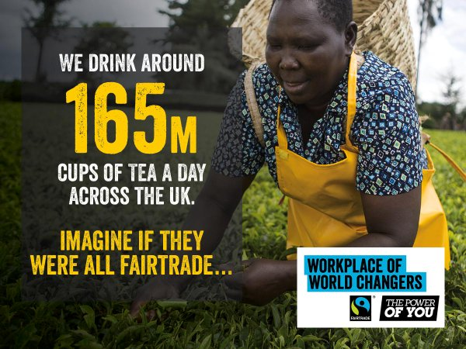


Notes:
If you’re interested in purchasing more Fairtrade products, then the Fairtrade Foundation have developed a National Purchasing Guide, which lists key suppliers around the UK. It features food & drink, hot beverages, non-consumables (cotton, beauty products, flowers), vending options and contract caterers. [Speak to the workplace you are visiting about their supplier needs – do they buy in coffee, tea and sugar or only have vending machines?]
Whether you’re sourcing food and drink for your office, planning an event and giving it a Fairtrade twist or want to sell Fairtrade items, this booklet has all of the answers.
The guide is available to view or download from the Fairtrade Foundation website, or just simply search ‘Fairtrade National Purchasing Guide 2016’ online.

Slide 13

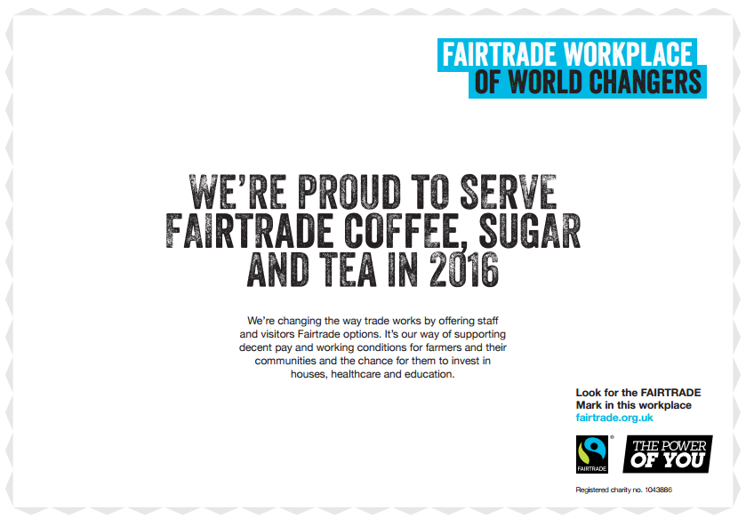
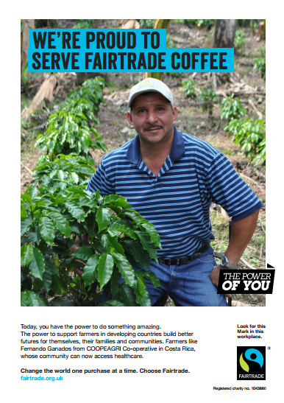


Notes:
The Fairtrade Foundation can offer a variety of free resources to help you promote your Fairtrade commitments at work:
A Workplace of World Changers certificate
Posters for each commodity (tea, coffee and sugar)
Window stickers for tea and coffee
In addition, they have a variety of other resources on the e-shop – from posters, leaflets and DVDs to inflatable bananas, cotton bags, balloons and mugs. Happy shopping!

Slide 14

Expand your Fairtrade product range
Shout about your commitment
Sign up to be a Workplace of World Changers
Notes:
Here are a few steps that businesses/workplaces can take to improve their commitment to Fairtrade
Use the Fairtrade National Purchasing Guide to help with the expansion of the product range
To shout about your commitment, use social media, display point of sale and other resource downloadable from the Fairtrade website or shop
Strengthen your commitment to Fairtrade through the Workplaces of World Changers programme. Many workplaces choose to support Fairtrade in fun ways by getting involved in Fairtrade Fortnight, joining up with their local Fairtrade Town for an event, or doing competitions and tastings in the office!

Slide 15
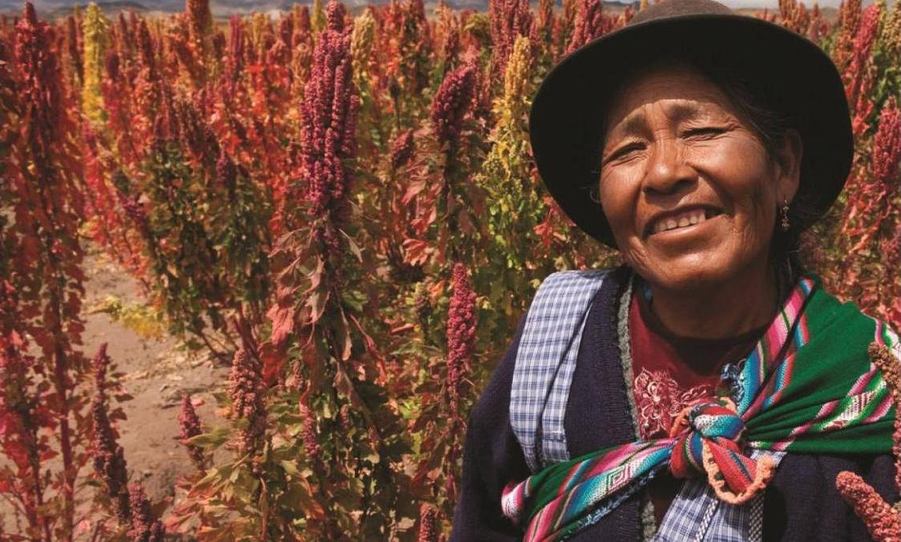

Email
Phone number
Notes:
Insert your contact info above if appropriate.
If not, link to www.fairtrade.org.uk
Open up for questions and thank the audience for listening. FAQs are available on the Fairtrade Foundation website to prepare yourself for questions. Remember, it’s perfectly fine to say ‘I’ll have to get back to you on that’ and take their email address if you don’t know the answer to a question, rather than fumbling or making something up!

