Slide 1
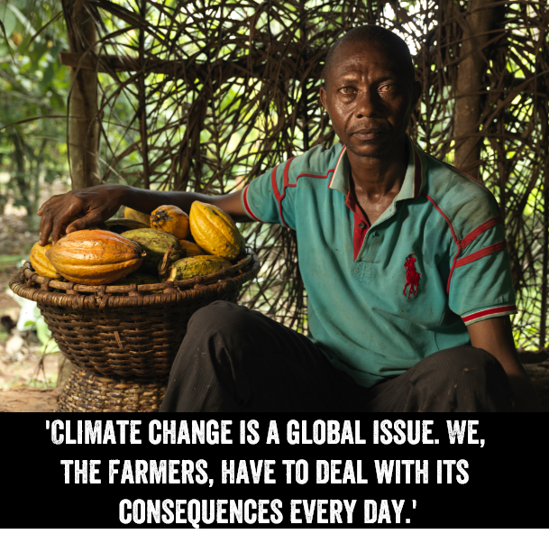
Climate change and economic justice

Slide 2
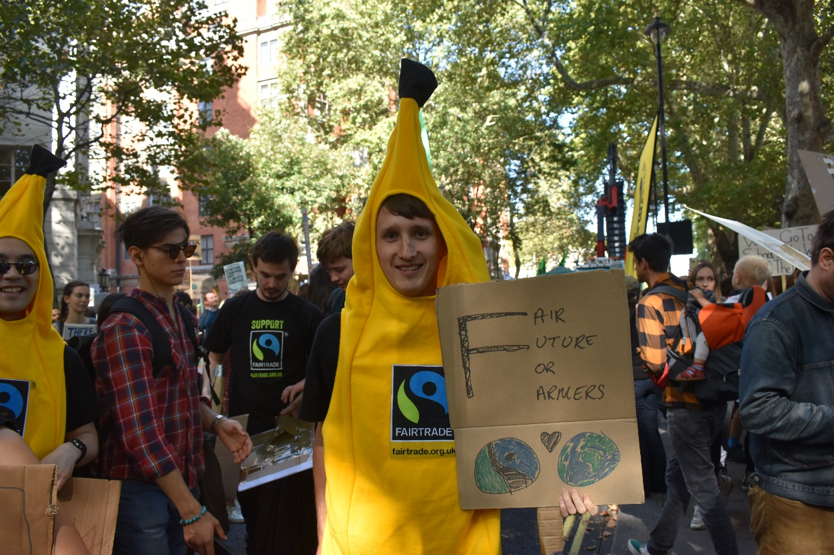
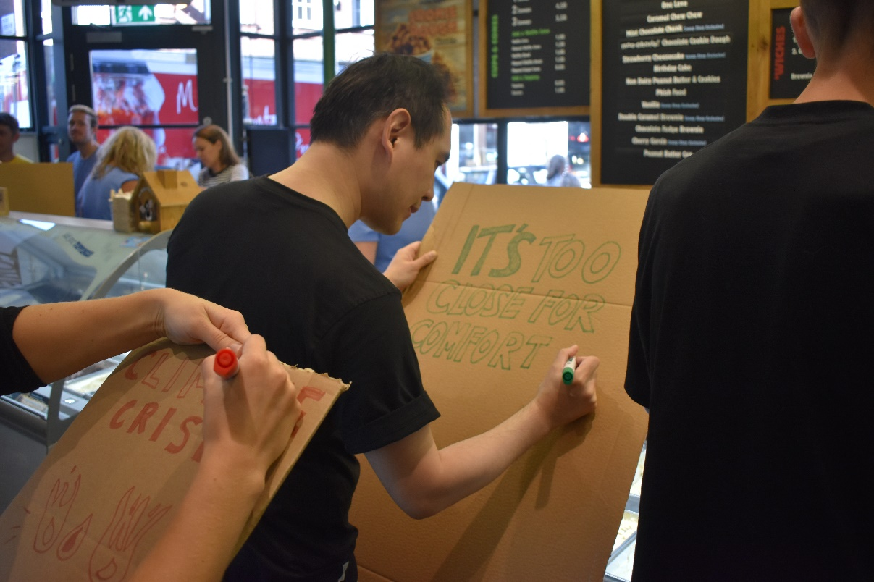
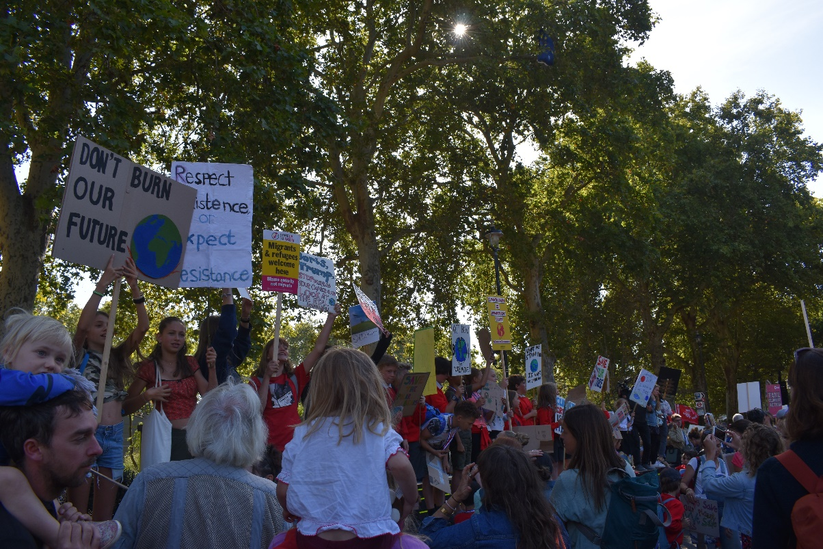
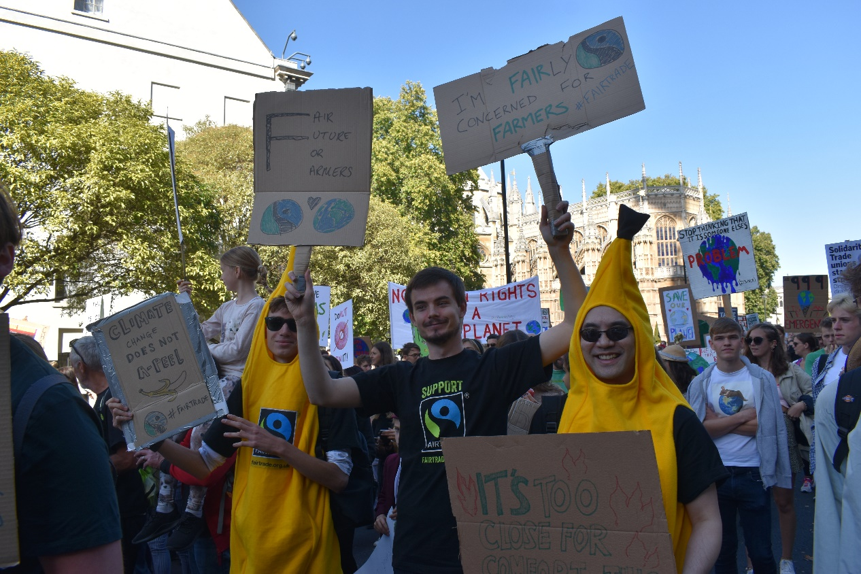
Question: What is one thing that’s made you think ‘I need to take action on this’ about the Climate Crisis?

Slide 3
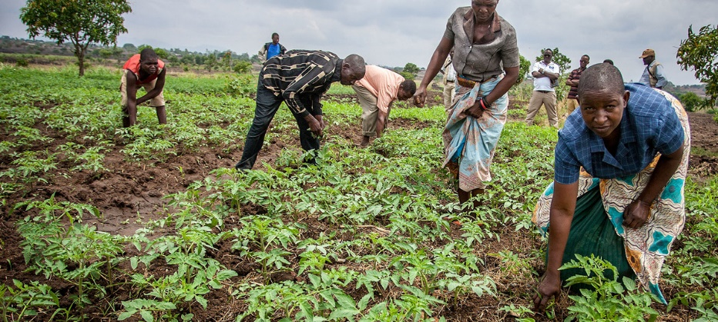
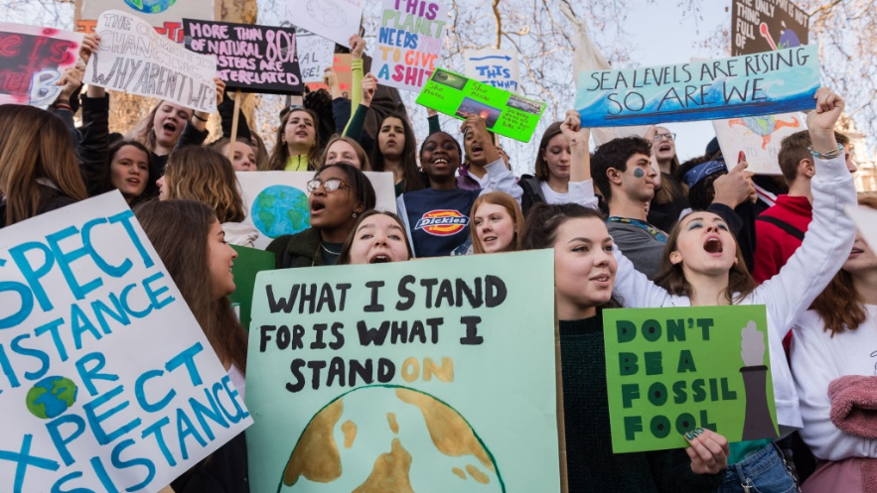
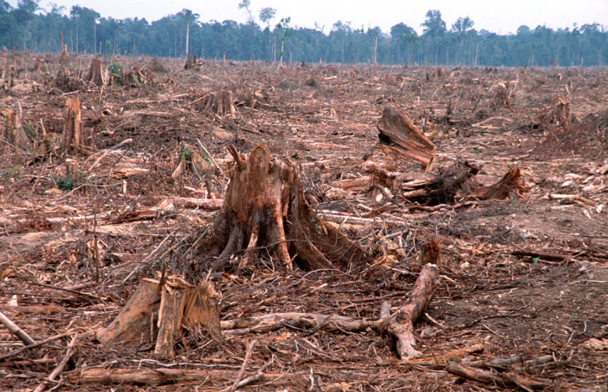
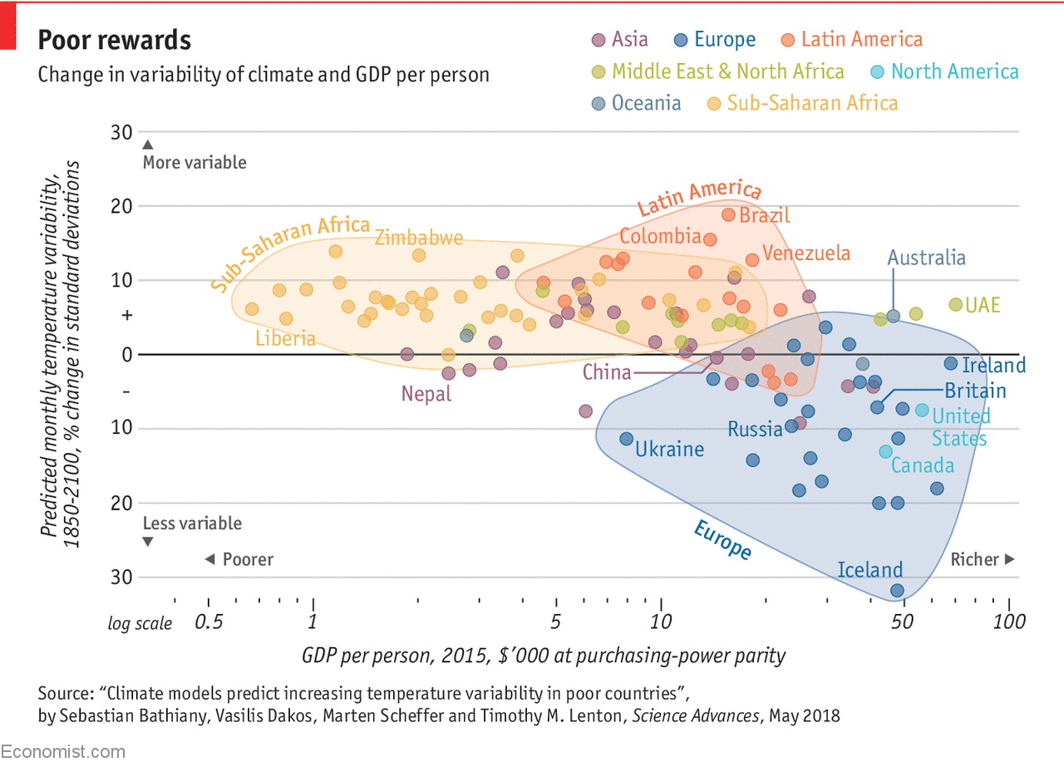
What would you like to know
more about by end of this session?

Slide 4
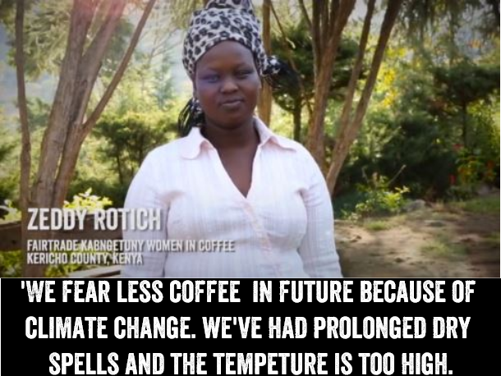
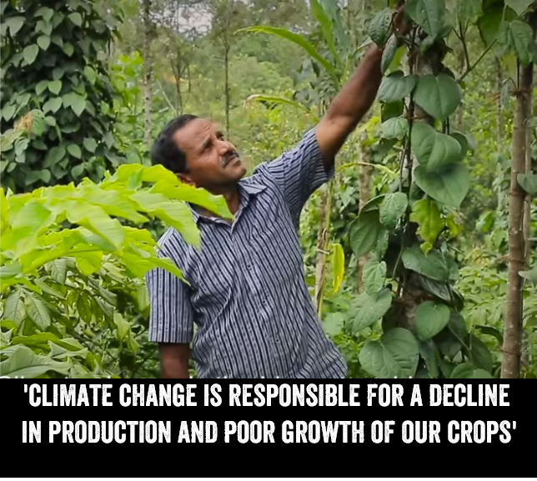
What does the climate crisis mean for fairtrade producers?
More volatile, less predictable seasons make agriculture harder
Heavy rains causing more plant diseases
Weather extremes leading to lack of food
Many Fairtrade crops – especially coffee – extremely vulnerable to small changes in temperature
25% of current coffee farms in Brazil & 37% in Indonesia likely to be lost to climate change if no action taken
Huge growth in fungal diseases destroying coffee plants in past decade
More frequent droughts, wet seasons and weather extremes hit production & cause plant diseases
Farmers get lower incomes
97% of tea smallholders in Assam say climate change is threatening their future
Notes:
1 Based on audit of FTT application and renewals showing average events organised, multiplied by no estimated active groups each year. Estimated reach based on between 30-60 at dedicated events and 100 engaged at larger events
2 Based on average number of workplaces, educational establishments, places of worship and community organisations engaged by groups to support Fairtrade at point of application (40.5), multiplied by 623 total number of communities awarded FTT status. Doesn’t include additional organisations engaged as local campaigns develop – no reliable data or estimates exist.
3 Based on 60% of regional/local F14 media coverage. Doesn’t include other year-round media coverage of group activities as not tracked year-on-year.

Slide 5
Contributed least, getting hit the hardest
Fairtrade farmers contributed the least to climate crisis – but are already feeling the worst effects
21 people from Cote d’Ivoire have same carbon footprint as one person in the UK
Things are only expected to get worse

Slide 6
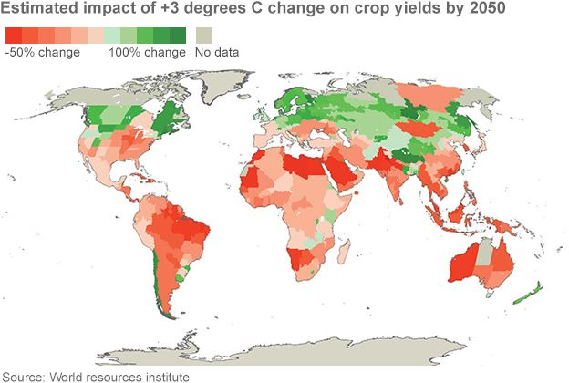
Contributed least, getting hit the hardest
Fairtrade farmers contributed the least to climate crisis – but are already feeling the worst effects
21 people from Cote d’Ivoire have same carbon footprint as one person in the UK
Things are only expected to get worse

Slide 7
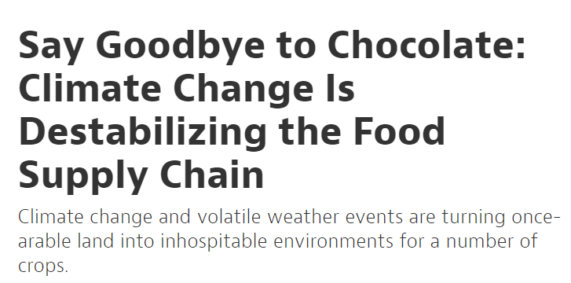
What will happen without action?
50% less land suitable for coffee growth across the world by 2050 – what will this mean for 25m people who earn an income from coffee?
Increased weather extremes in India to reduce tea production – and increase diseases that destroy crops
Wine production in South Africa to fall by 50%, 40% in Chile
Many current cocoa growing regions in Ghana and Cote d’Ivoire will become too hot to grow cocoa by 2050
Higher altitude areas, currently valuable forested, biodiverse areas, will likely be cleared to become cocoa farms
Notes:
Schools are an effective route to show the wider public the values of the Fairtrade brand, through a core teacher multiplier audience which is highly trusted
Teachers are very receptive to Fairtrade, have a good understanding of it compared to wider public (because of the support we offer) and are often Connected Champions / Solo Supporters
Local media generated by schools’ activities and engagement accounts for a huge proportion of our earned media
Children influence parents- Most parents would fit into the hard-to-reach Busy Passer By segment and one of the few successful routes of getting to them is by inspiring their kids. Some of the resources specifically include resources to take home to complete with parents.

Slide 8
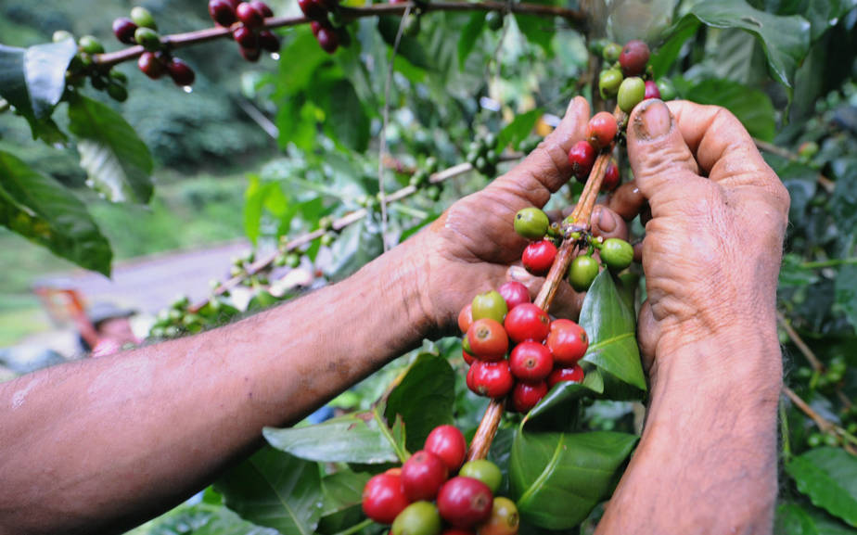
Why fairtrade needs to act on climate change
Because of everything we just read!
But also because it’s the priority for so many farmers and workers we speak with – it’s a damaging reality for their communities right now
We’re part-owned by farmers, so their priority is our priority
Notes:
Schools are an effective route to show the wider public the values of the Fairtrade brand, through a core teacher multiplier audience which is highly trusted
Teachers are very receptive to Fairtrade, have a good understanding of it compared to wider public (because of the support we offer) and are often Connected Champions / Solo Supporters
Local media generated by schools’ activities and engagement accounts for a huge proportion of our earned media
Children influence parents- Most parents would fit into the hard-to-reach Busy Passer By segment and one of the few successful routes of getting to them is by inspiring their kids. Some of the resources specifically include resources to take home to complete with parents.

Slide 9
How fairtrade can help tackle the climate crisis
Fairtrade can not solve the Climate Crisis on it’s own. But we can be an important part of tackling it through:
Advocacy – as campaigners in this country making sure producers pleas for action are heard
Adaption – Climate change is already harming communities. Fairtrade is helping them adapt.
Avoiding emissions – Our Fairtrade Standards aim to minimise the emissions produced in any Fairtrade products.

Slide 10
The fairtrade standards and tackling the climate crisis
All Fairtrade products have to meet the Fairtrade Standards
Strict provisions on environment, including measures to tackle climate change like:
Monitoring and reducing carbon emissions
Prohibiting on deforestation
Tackling soil erosion
Reducing water wastage
Question: How do you think these Fairtrade Standards help farmers? And how do they link the climate change?

Slide 11
Fairtrade minimum price and premium: how does that help tackle the climate crisis?
The higher income Fairtrade Minimum Price and Fairtrade Premium can provide is vital in allowing Fairtrade producers to focus on better environmental protection
Allows sustainable, long-term planning
Allows farmers to practice more environmentally-friendly farming.
And Fairtrade Premium projects are frequently invested directly in environmental protection measures – for example
Notes:
Training on good farming practices also reduces co2 emissions

Slide 12
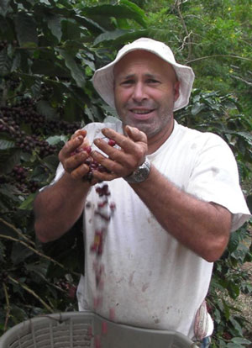
Fairtrade Premium projects: fighting for the environment
COOCAFE, coffee producing cooperative in Costa Rica
COOCAFE have started a Foundation, part-funded by Fairtrade Premiums, committed to reforestation, water recycling and other environmental initiatives to tackle climate change.
Notes:
Training on good farming practices also reduces co2 emissions

Slide 13
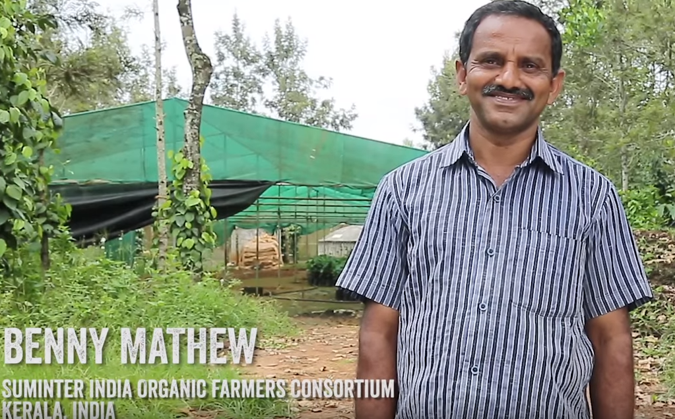
Fairtrade Premium projects: fighting for the environment
Suminter India Organic Farmers, cooperative in Kerala, India
Invested Fairtrade Premium in Solar Panels, meaning halved the amount of wood they need to burn to dry seeds.
Notes:
Training on good farming practices also reduces co2 emissions

Slide 14
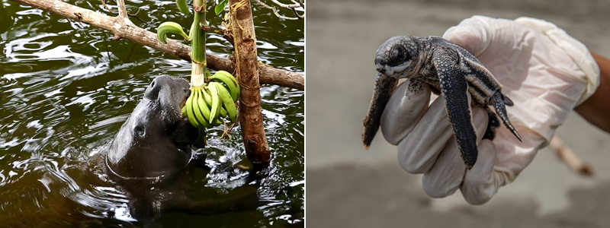
Fairtrade Premium projects: fighting for the environment
Coobana, banana producing cooperative in Panama
Coobana Co-operative in Panama use a slice of their Fairtrade Premium to protect endangered turtles that hatch on beaches nearby. These banana eating river manatees even won the support of members!
Notes:
Training on good farming practices also reduces co2 emissions

Slide 15
Fairtrade Premium projects: fighting for the environment
Growing Women in Coffee, Kenya
Invested in biogas stoves so no longer need to cut down near-by trees for firewood. Lessening emissions and protecting local environment.
Notes:
Training on good farming practices also reduces co2 emissions

Slide 16
Farmers are taking action – but what can we do?
Educate – our research shows people don’t associate Fairtrade with tackling the climate crisis. We need to change that.
Campaign – We don’t need to do it alone – let’s make friends! Can you link up with your local environmental groups?

Slide 17
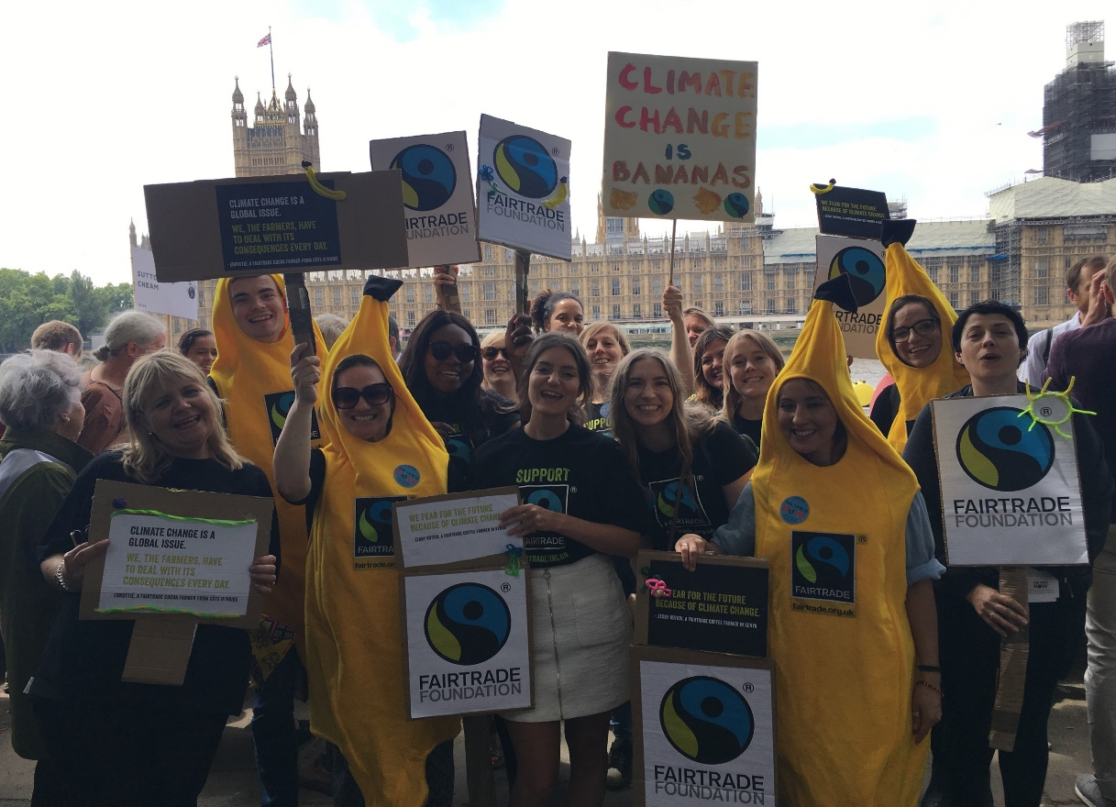
Who can we link up with?
At a national level – Fairtrade is a member of the Climate Coalition
Many Fairtrade Foundation organisations are active in campaigning on Climate Crisis – Oxfam, CAFOD and Christian Aid for example
At a local level – you know best! Extinction Rebellion? Church groups? the WI?

Slide 18
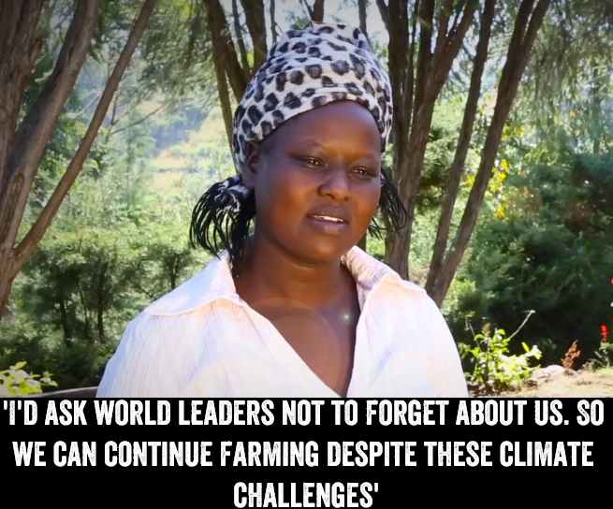
Why is it important we get involved?
Question: What opportunities there are for you to campaign on climate change and economic justice in your area? Who could you link up with?
Notes:
Maybe you think, if all these great organisations are speaking about the Climate Crisis, do we really need to? After all Fairtrade doesn’t need to do anything.
I think the answer to that is in another quote from Zeddy, the Kenyan coffee are farmer we met earlier. In the debate about climate change, who else is giving her a voice?
The discussion is more often about the effects on people in this country. Or the long-term future of products like tea and coffee.
But while big companies will probably find a way to adapt to severe climate change – maybe by cutting down more valuable rainforest to plant bigger farms, using more local resources.
But it’s going to be much harder for small-holder farmers and cooperatives. Who are doing the right thing by adhering to the Fairtrade Standards, often growing organically, investing their profits in the community and operating democratically. Fairtrade needs to speak up for them in the Climate Crisis.

Slide 19
Myth-busting: fairtrade
Myth: “Fairtrade is about price, labour rights, things like that. Other certifications do environment.”
Environmental protection has always been at the heart of Fairtrade Standards, and recently they’ve got even stronger. Fairtrade rewards and encourages farming and production practices that are environmentally sustainable.
Myth: “Fairtrade products have huge carbon footprints because flying products in”
Actually climate and production method often means products produced on Fairtrade terms have a lower carbon footprint than those produced closer to the UK. For examples, Kenyan vs. Netherlands roses

Slide 20
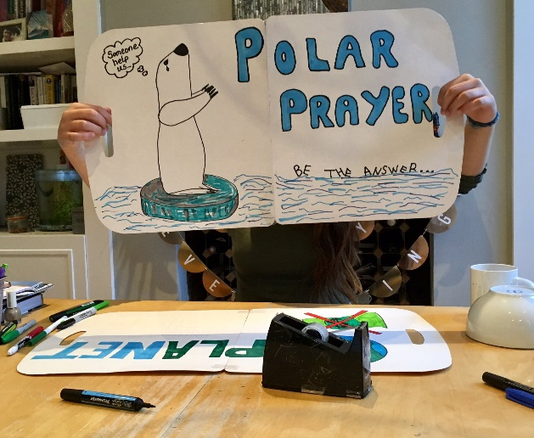
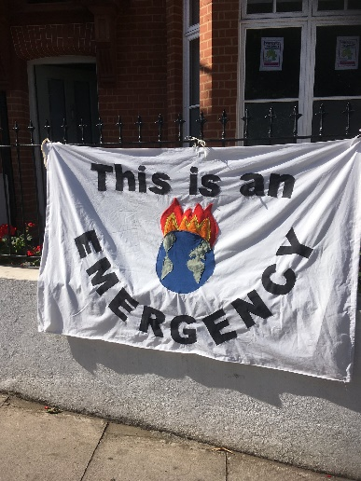
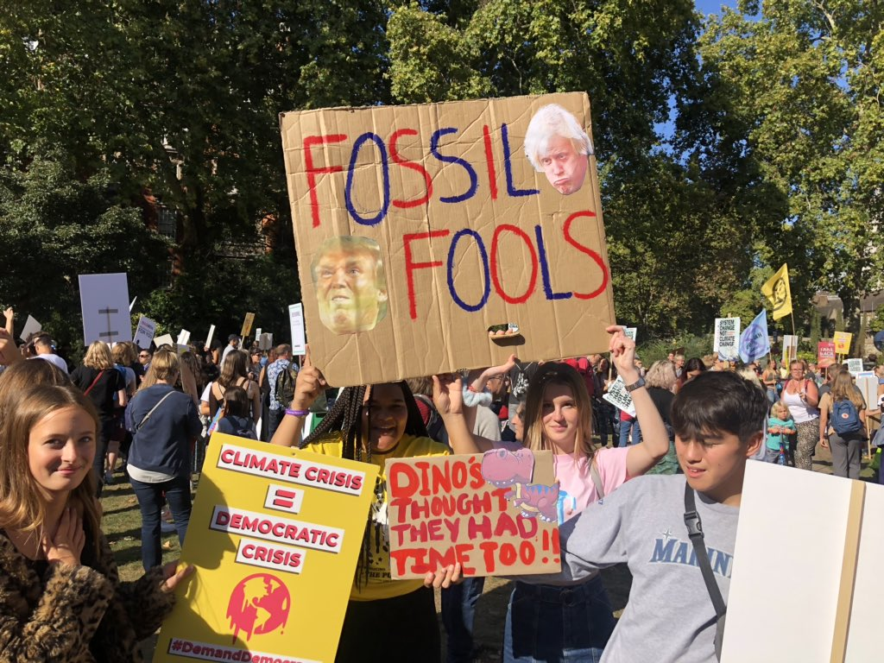
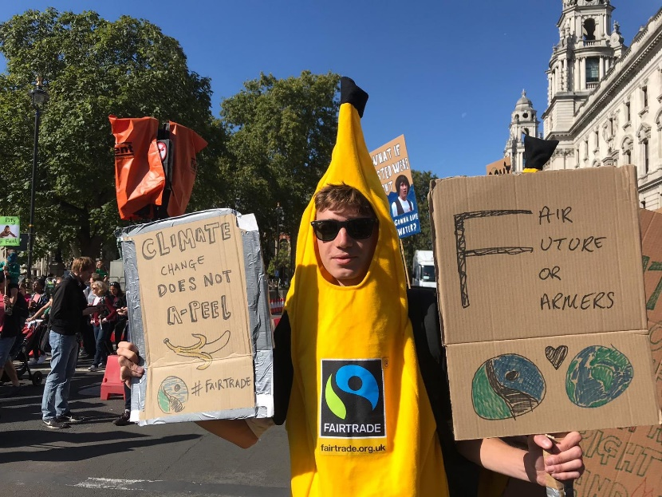
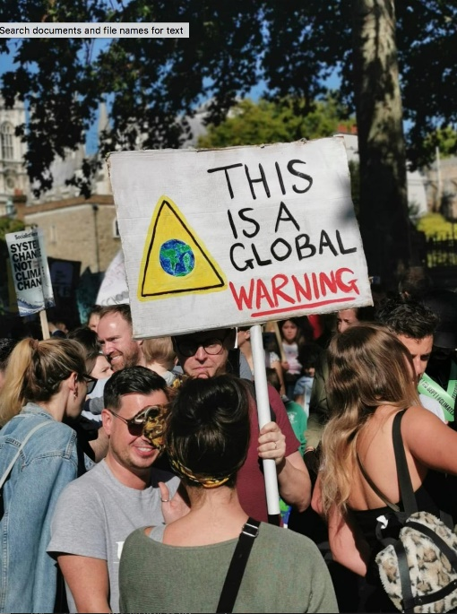
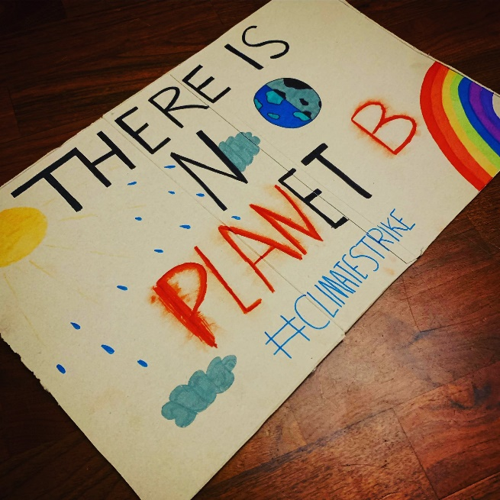
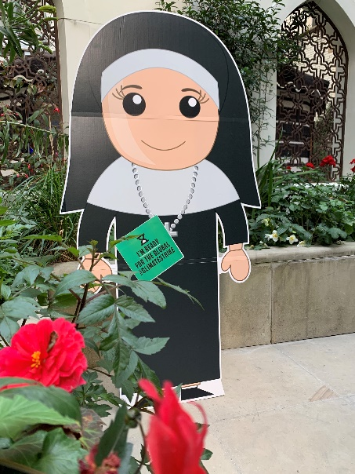
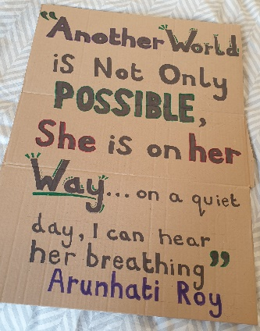
What’s on
your sign?
Any questions?
Notes:
Yesterday we were at the Climate Strike protests in London, along with lots of other people and organisations.
These protests always produce a lot of hand-made signs like you see here.
What do you think would be good to have on a Fairtrade climate change sign? What do you think is the most important message to get across? And how would you do it in a fun way?
You can actually draw out a sketch of your sign if you like – or just talk it through with a group

Slide 21
Thank you for coming!
Any questions?
Notes:
Yesterday we were at the Climate Strike protests in London, along with lots of other people and organisations.
These protests always produce a lot of hand-made signs like you see here

