Slide 1
The Crystal 10 October 2018
#futureoftrade

Slide 2
Gender equality in
global trade

Slide 3
GENDER EQUALITY IN GLOBAL TRADE
Chair: Claudia Fumo
DFID
#futureoftrade

Slide 4
GENDER EQUALITY IN GLOBAL TRADE
Tsitsi Choruma
Fairtrade Africa
#futureoftrade

Slide 5
GENDER EQUALITY IN GLOBAL TRADE
Awa Traoré
CAYAT
#futureoftrade

Slide 6


THE FUTURE IS NOW
FAIRTRADE – A GUIDING LIGHT FOR WOMEN PRODUCERS

Slide 7
Women and Men in CAYAT
TOTAL MEMBERSHIP = 2343
WOMEN PRODUCERS IN COCOA = 256
MALE PRODUCERS IN COCOA = 2087
Producing 8,000 Tonnes / Year

Slide 8
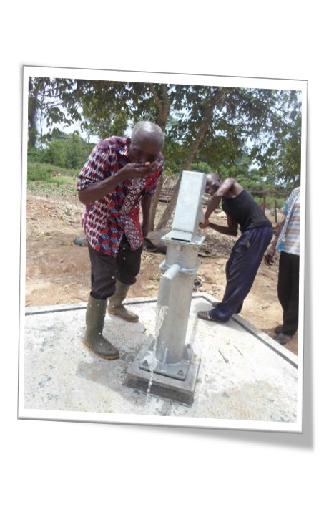
WE GOT IMPACT
SAFE WATER FOR 3 OF THE MOST GEOGRAPHICALLY EXCLUDED AREAS

Slide 9
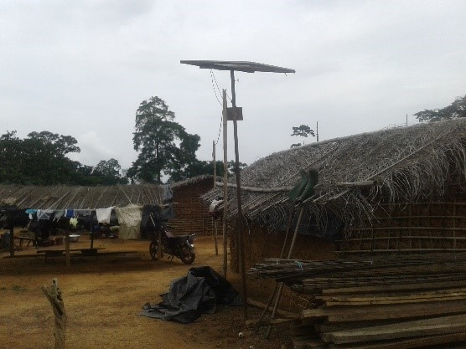
WE GOT IMPACT
SOLAR PANELS FOR 3 OF THE MOST GEOGRAPHICALLY EXCLUDED AREAS

Slide 10
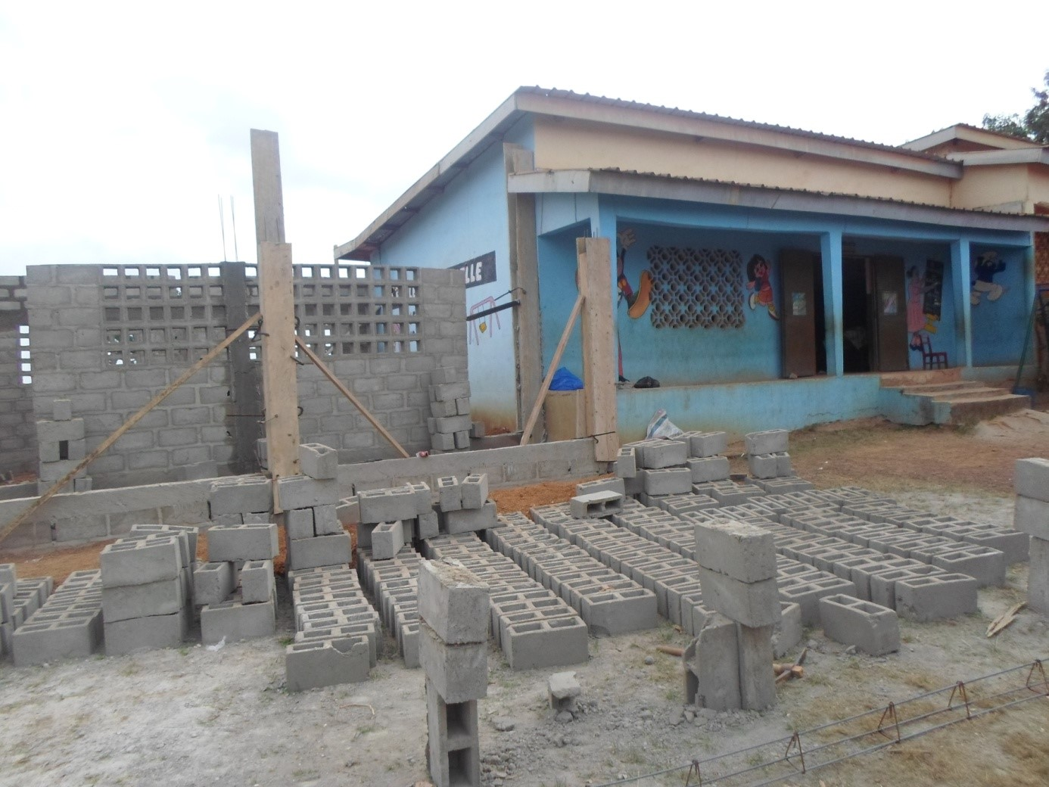
WE GOT IMPACT
£33 000
2 SCHOOLS FOR 300 CHILDREN

Slide 11
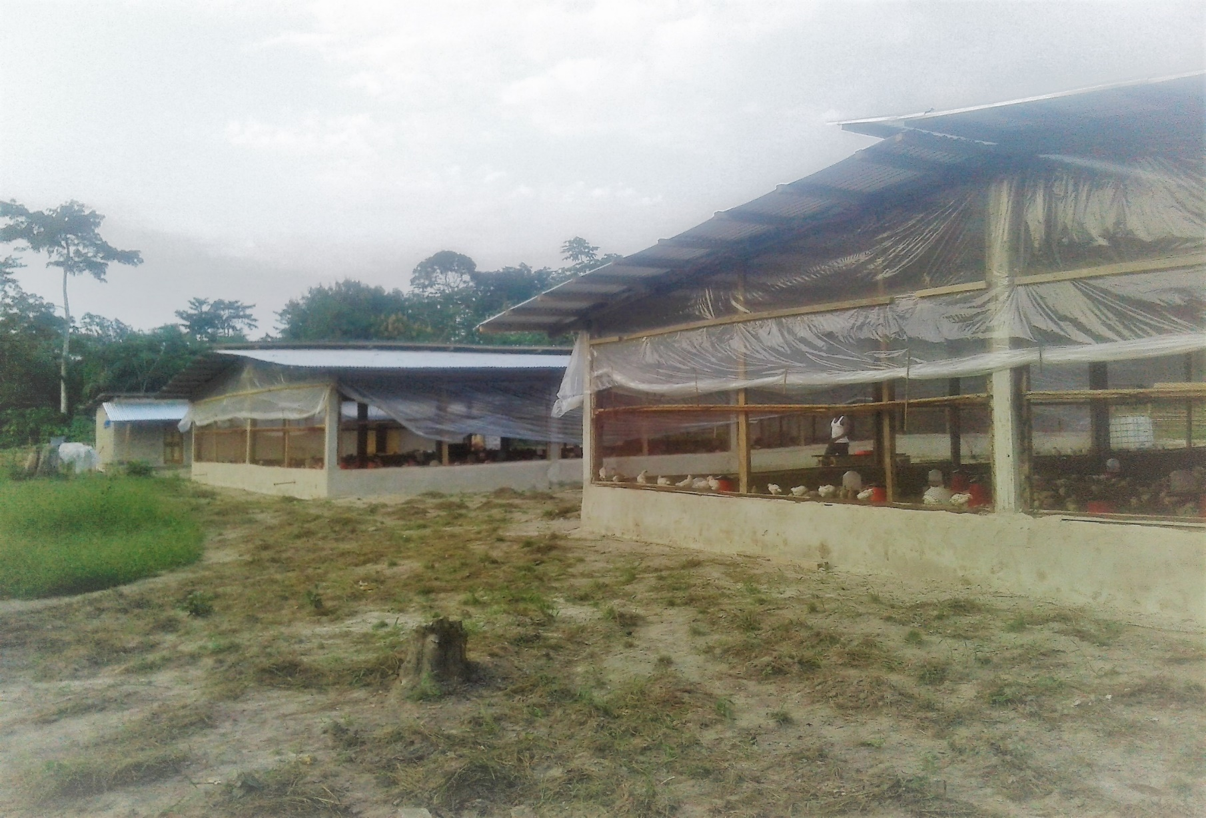
WE GOT IMPACT
INCOME FOR WOMEN BIO-FERTILIZER FOR PRODUCERS
A HENHOUSE - 6000 EGGS SOLD

Slide 12
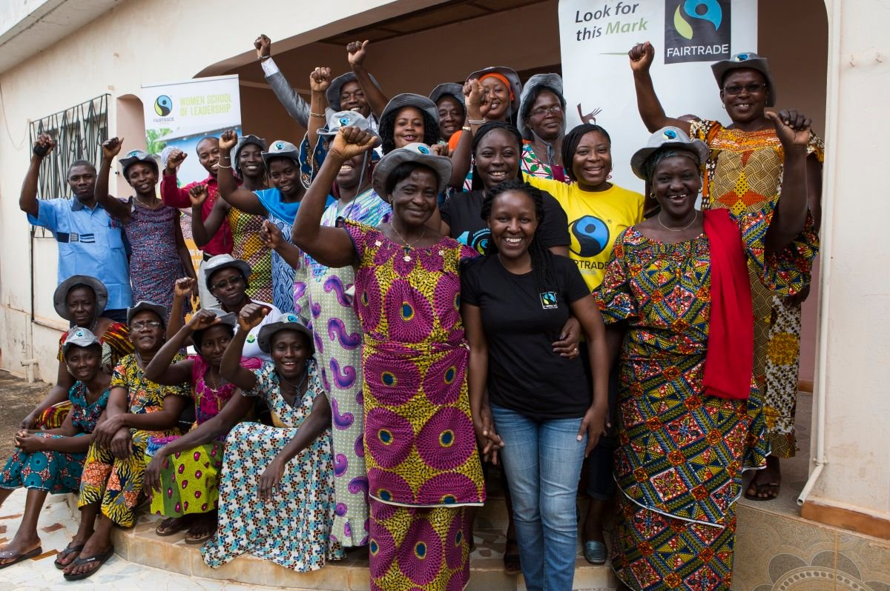
WE GOT IMPACT
WOMEN’S LEADERSHIP
3 STUDENTS FROM FTA –WOMEN’S LEADERSHIP SCHOOL

Slide 13
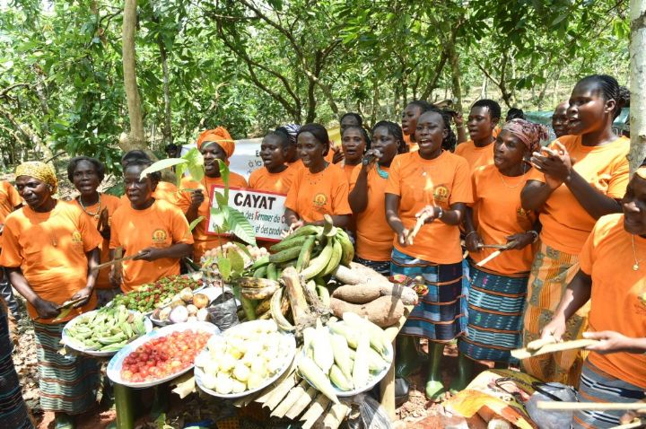
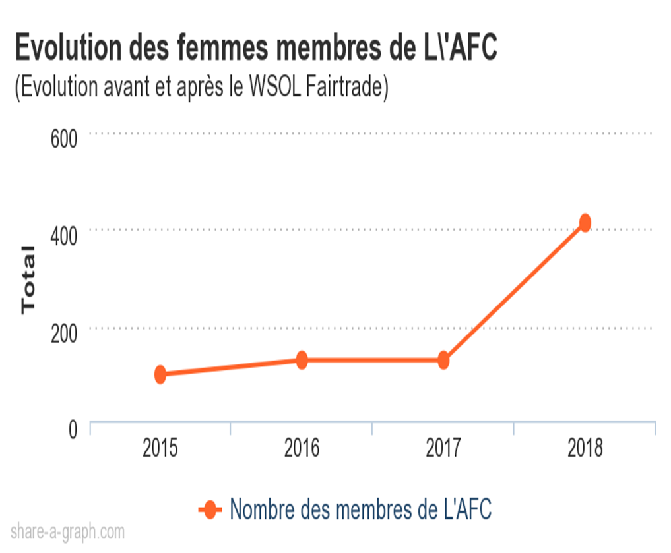
WE GOT IMPACT
WOMEN’S SCHOOL OF LEADERSHIP
4 X
From 100 to 413 members through the school of leadership that has enabled women to train and empower women in their communities

Slide 14


WE GOT IMPACT
WOMEN’S LEADERSHIP
EMPOWERMENT COACHING - 127 WOMEN

Slide 15

WE GOT IMPACT
DEMOCRACY
RADIO-CAYAT THE FARMER’S RADIO

Slide 16
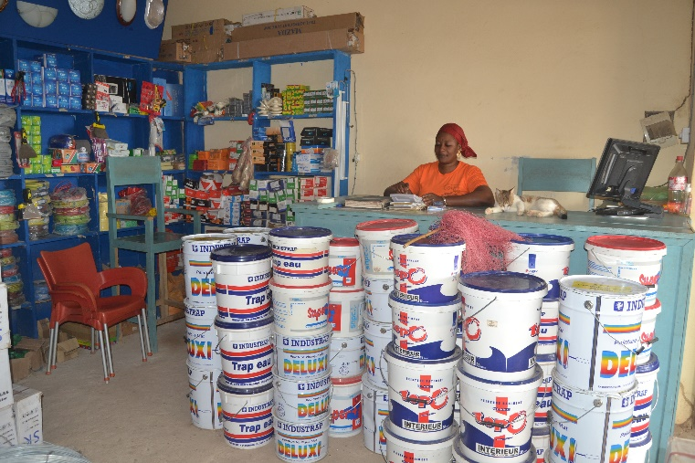
WE GOT IMPACT
INCOME DIVERSIFICATION INITIATIVE
CAYAT FARMER’S SHOP

Slide 17


FUTURE PLANS
WOMEN’S LEADERSHIP
£134,541.39
BUILDING A SCHOOL FOR PRODUCER’S CHILDREN AND COMMUNITY

Slide 18
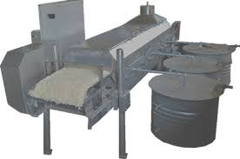
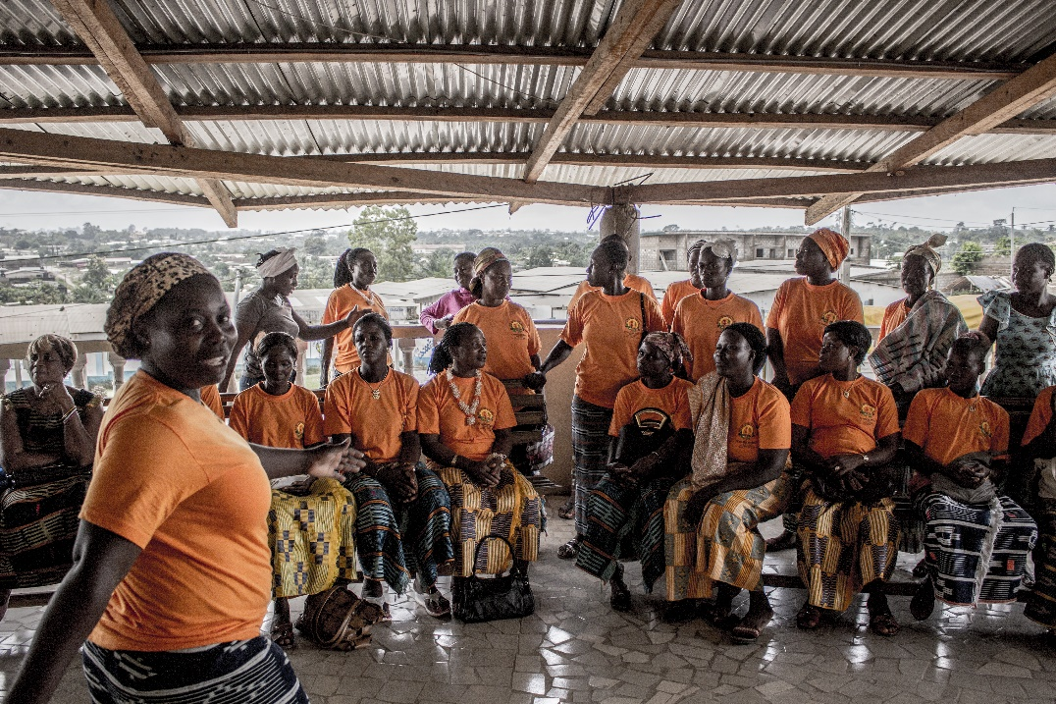
FUTURE PLANS
WOMEN’S LEADERSHIP
£26,908.28
TO EQUIP OUR WOMEN WITH A CASSAVA PROCESSING PLANT

Slide 19

WWW.CAYAT.CO0p
OUR NEW WEBSITE IS COMING SOON

Slide 20

THANK YOU
Thank you
JOIN US TO MAKE A FAIRER WORLD

Slide 21
GENDER EQUALITY IN GLOBAL TRADE
Cathryn Higgs
The Co-operative
#futureoftrade

Slide 22
GENDER EQUALITY IN GLOBAL TRADE
Nerea Craviotto
ITUC
#futureoftrade

Slide 23
Barriers to achieving gender equality in global supply chains?
Corporate greed (that affects us all – women and men) coupled with gender stereotypes on different levels;
Feminisation of precarious work, very much related with the gendered distribution of care work; but also stereotypes around gender;
Global Supply Chains fail to take into account risks to women’s rights abuses.

Slide 24
Achieving gender equality in global trade
Trade unions - they empower themselves and they go and take what is theirs: their rights;
Many countries, especially countries with ‘cheap labour’ policies, fight unions for this very reason.
A solution to this is provided by the strict application of the UN Guiding Principles for Business and Human Rights that require states to protect all human rights in their territory, and also companies to respect all human rights in their operations.

Slide 25
From policy to practice
Turning the voluntary UN Guiding Principles into a legal requirement with penalties and fines and revocation of licenses for those companies that consistently fail to update their model of production and procurement.
Furthermore, if UNGPs were to be followed, the supply chains would need to be re-designed

Slide 26
Thank you!

Slide 27
The Crystal 10 October 2018
#futureoftrade

