Slide 1
The Crystal 10 October 2018
#futureoftrade

Slide 2
TOWARDS A LIVING INCOME
#futureoftrade

Slide 3

TOWARDS A LIVING INCOME

Slide 4
My Understanding of a Living Income…
I have an in-depth understanding
I have a reasonable understanding
This is a new issue for me
#futureoftrade

Slide 5
Living Income definition…
A LIVING INCOME is the net annual income required for a family in a particular place to afford a decent standard of living for all members of that family.
Elements of a decent standard of living include: food, water, housing, education, healthcare, transport, clothing, and other essential needs, including a provision for unexpected events.
(ISEAL Living Income Community of Practice)
#futureoftrade

Slide 6
Living Income Benchmark
cost of nutritious low-cost diet
cost of basic decent housing
other essential expenses for education, health-care, clothing, transport, etc.
provision for unexpected events
+
+
+
cost of a basic, decent living for a typical household size
net income from primary crop
net income other crops & livestock
value of self-consumed crops & livestock
off-farm income
+
+
+

Slide 7
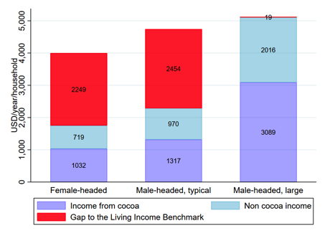
Actual income vs Living Income in Ghana cocoa
Source: Smith, 2018

Slide 8
Why is work on
Living Income
NEEDED?
#futureoftrade

Slide 9
Is living income achievable in your sector within 5 years?
Yes, absolutely
No, it’s too difficult
I’m not sure
#futureoftrade

Slide 10
What can businesses do
to ensure farmers earn a
Living Income?
#futureoftrade

Slide 11
My Understanding of a Living Income…
Has improved
Has stayed the same
I have more questions than before
#futureoftrade

